Slide 1

Welcome!
News, Updates & Reminders
Graduate School Department

Slide 2

Dr. Sarah Larsen
Vice Provost and Dean of the Graduate School Dept.

Slide 3
Updates from the Graduate School
Graduate enrollment concerns
  Master’s student enrollment continued to decline
  Doctoral student enrollment was steady but new doctoral students were down 20%
  Professional student enrollment was down slightly.
Notes:
New Staff/Transitional

Slide 4
GRADUATE ENROLLMENT

Slide 5
Trends in Enrollment: UH NEW Doctoral Students (Admissions Data)
499
Decline in new doctoral students after 4 years of increases
Both international and domestic students declined.
Yield declined from ~60% to 56%.
394

Slide 6
Trends in Enrollment: UH NEW Master’s Students (Admissions Data)
1400
1291
Decline in new master’s students for 3rd year
Both international and domestic students declined.

Slide 7
Initiatives
Cross-campus graduate recruiting group
  Better coordination of recruiting efforts
  Optimization of business processes related to recruiting and admissions
Graduate Enrollment Task Force
  Establish long and short term strategies to increase graduate enrollment
  Representatives from each college

Slide 8
Professional Development
New resource
  DoctoralNet
  https://www.youtube.com/watch?v=2fmCA1_Yq5s&feature=youtu.be
Professional development resources (new web page):
http://www.uh.edu/graduate-school/graduate-professional-and-personal-development/

Slide 9
Shari Corprew
Director of Graduate School Dept.
No updates at this time.

Slide 10

Tashemia V. Jones, Ed.D.
Assistant Director of Programs/Student Records

Slide 11
New Policy Fall 19
Take Down UH Libraries Digital Repositories Takedown Request Form
Beginning F19:
  Thesis/Dissertation Front Matter http://www.uh.edu/graduate-school/academics/thesis/
  Written Thesis/Dissertation Approval Form http://www.uh.edu/graduate-school/academics/thesis/written-thesis-dissertation-approval-form-082019.pdf

Slide 12
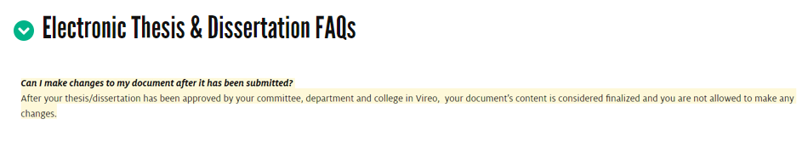
Policy updates & Reminders
Making changes to a document after it has been approved by the committee

Slide 13
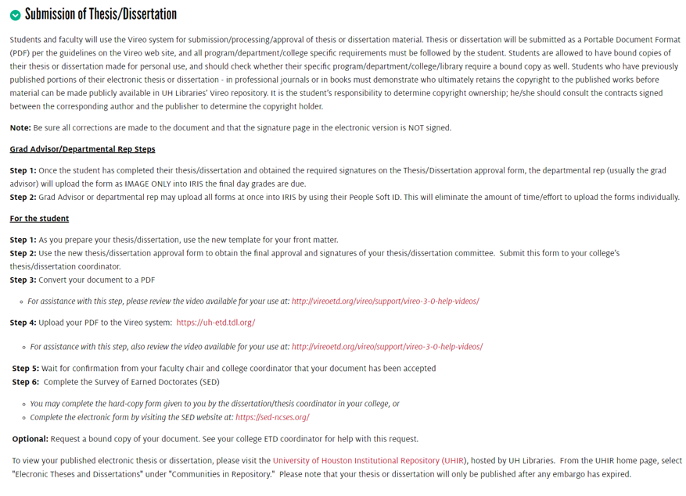
Policy updates & Reminders

Slide 14
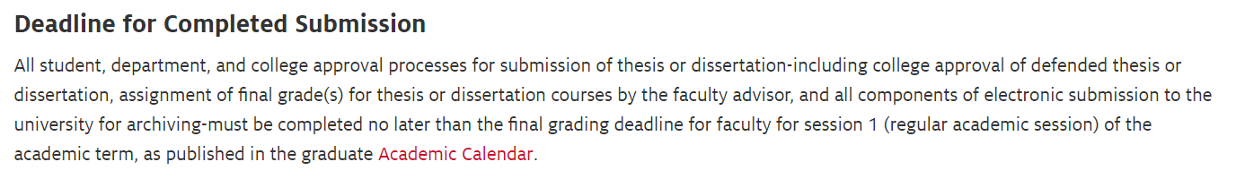
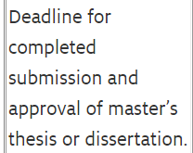

Submission deadlines
Thesis and Dissertation Policies

Slide 15

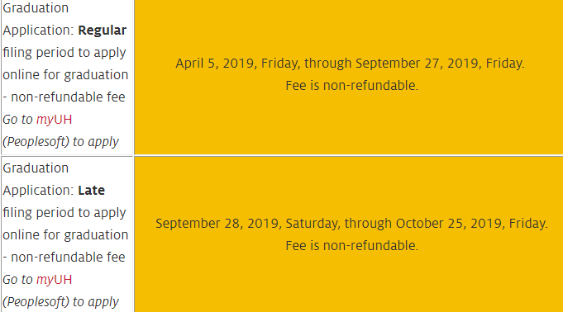

Slide 16
Shawn Washington
Assistant Director of Grad/Int’l Admissions.

Slide 17
FA2019 Term Reminders
Archiving Fall Applications – Sept 27th
175 app’s currently pending a decision
No decision – Applications will be changed automatically to ”Withdrawal Status” in CN and withdrawal letters released.
Notes:
New Staff/Transitional

Slide 18
Deactivating CN Access:
Faculty and Staff Members
Response Deadline: Oct 1st
Coordinators/Assistant Deans/Designee
Help Desk (gradschool@uh.edu)
CC: Me
Notes:
New Staff/Transitional

Slide 19
UHGS Recruitment Group
Open to everyone interested in sharing recruitment ideas
Meet monthly
Senate Rm (M.D. Anderson Library)
Share Drive Folder:
https://uofh.sharepoint.com/:f:/s/graduate-school/EsLl2ddidnNPibTyeVHW9UsB9Vn3L46AZdEp9BvhRoCI3w
Notes:
New Staff/Transitional

Slide 20
Recruitment Topics
http://www.uh.edu/graduate-school/forms/graduate-enrollment-data/
Coordinate Events – (Texas Swing Calendar)
UH Graduate School Recruitment Event (10.10.2019)
Interviewing for GS Admissions Recruiter
Reporting Outcomes
Notes:
New Staff/Transitional

Slide 21
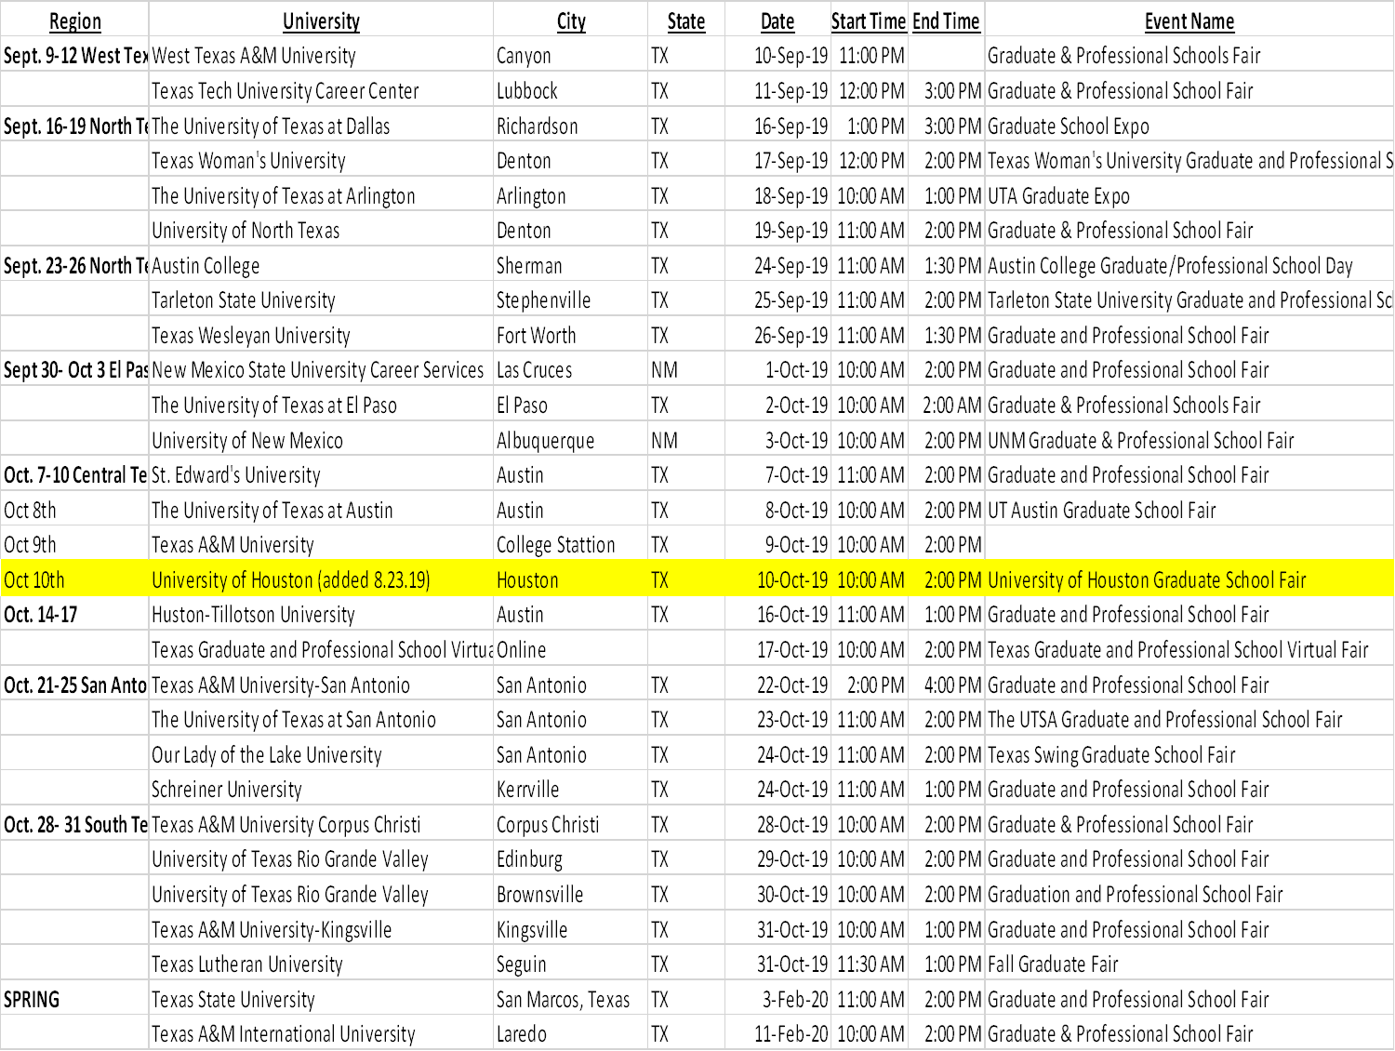
Notes:
New Staff/Transitional

Slide 22
Sign up Form
: https://uofh.sharepoint.com/:f:/s/graduate-school/EsLl2ddidnNPibTyeVHW9UsB9Vn3L46AZdEp9BvhRoCI3w
Region | University | City | State | Date | Start Time | End Time | Architecture | Arts | Business | Engineering | Hilton | CLASS | NSM | Social Work | COT | Pharmacy | Optometry | Hobby | Total Attending
Sept. 9‐12 West Texas | West Texas A&M University | Canyon | TX | 10‐Sep‐19 | 11:00 PM |  | Shawn Washington swashington4@uh. |  |  |  |  |  |  |  |  |  |  |  | 1
 | "Texas Tech University Career Center" | Lubbock | TX | 11‐Sep‐19 | 12:00 PM | 3:00 PM |  |  |  |  |  |  |  |  |  |  |  |  | 0
Sept. 16‐19 North Texas I | Texas Woman's University | Denton | TX | 17‐Sep‐19 | 12:00 PM | 2:00 PM |  |  |  |  |  |  |  |  |  |  |  |  | 0
 | The University of Texas at Arlington | Arlington | TX | 18‐Sep‐19 | 10:00 AM | 1:00 PM |  |  |  |  |  |  |  |  |  |  |  |  | 0
 | University of North Texas | Denton | TX | 19‐Sep‐19 | 11:00 AM | 2:00 PM |  |  |  |  |  |  |  |  |  |  |  |  | 0
Sept. 23‐26 North Texas II | The University of Texas at Dallas | Richardson | TX | 23‐Sep‐19 | 1:00 PM | 3:00 PM |  |  |  |  |  |  |  |  |  |  |  |  | 0
 | Austin College | Sherman | TX | 24‐Sep‐19 | 11:00 AM | 1:30 PM |  |  |  |  |  |  |  |  |  |  |  |  | 0
 | Tarleton State University | Stephenville | TX | 25‐Sep‐19 | 11:00 AM | 2:00 PM |  |  |  |  |  |  |  |  |  |  |  |  | 0
 | Texas Wesleyan University | Fort Worth | TX | 26‐Sep‐19 | 11:00 AM | 1:30 PM |  |  |  |  |  |  |  |  |  |  |  |  | 0
Sept 30‐ Oct 3 El Paso/New Mexico | New Mexico State University Career Services | Las Cruces | NM | 1‐Oct‐19 | 10:00 AM | 2:00 PM |  |  |  |  |  |  |  |  |  |  |  |  | 0
 | The University of Texas at El Paso | El Paso | TX | 2‐Oct‐19 | 10:00 AM | 2:00 AM |  |  |  |  |  |  |  |  |  |  |  |  | 0
 | University of New Mexico | Albuquerque | NM | 3‐Oct‐19 | 10:00 AM | 2:00 PM |  |  |  |  |  |  |  |  |  |  |  |  | 0
Notes:
New Staff/Transitional

Slide 23
Recruiting Group
Next Meeting – 10/11/19 (Library)
Reconfirm TX Swing events
Recap UHGS Recruitment Event
Best Practices Discussion
Notes:
New Staff/Transitional

Slide 24

Notes:
New Staff/Transitional

Slide 25
I-20 processing
Christen Gould
SEVIS Compliance Coordinator

Slide 26
I-20 Deferments
A new offer letter is required
  Student will be asked to present a new offer letter in the visa interview
Decision must be updated in Peoplesoft before I-20 can be issued
I-20 can be deferred up to one year (SEVIS fee is only good for one year)
Notes:
New Staff/Transitional

Slide 27
Please remember
I-20 documents are processed once all documents have been received
  If documents are missing, the student will get 3 reminders to submit documents. Reminders are spaced 1 week apart. The email will be sent automatically through CollegeNet.
Required Documents
  Current passport (cannot be within 6 months of expiration
  Proof of financial support
    Can include bank statements, education loan award letters, credit account statements,
    Students can be sponsored by a third party with written permission from sponsor.
  Letter of financial backing
    Required of Student is sponsored by 3rd party
Notes:
New Staff/Transitional

Slide 28
Please remember
Documents take at least 2 business days to process.
  The 2 business days are measured after all required documents are received, and if the CollegeNet I-20 request is submitted correctly.
    I am not automatically notified when students upload documents. Encourage your students to email gradschool@uh.edu when documents have been uploaded.
  The Graduate School cannot predict SEVIS errors, or student document submission timelines.
Notes:
New Staff/Transitional

Slide 29
I-20 processing
Spring processing has started
  Spring new admissions and deferred applications
    Current Students and transfers will be processed at the close of the Fall 2019 semester.
Fall 2020 processing will begin in February of 2020
Notes:
New Staff/Transitional

Slide 30
New Office Location
My office has moved!
  I am now located in 102E in the E Cullen building.
    I have walk-in hours to see students on Tuesday and Thursday afternoons from 12 noon to 3 PM.
    I-20 documents are available for pick-up during those hours.
Notes:
New Staff/Transitional

Slide 31
Chastyne Blacklock
[Executive Assistant to Dr. Larsen & Events Coordinator]

Slide 32

GRADUATE SCHOOL FAIR
WHEN: OCTOBER 10, 2019
10AM – 2PM
WHERE: BUTLER PLAZA
GRADUATE RESEARCH SHOWCASE
3MT & POSTER SESSION (Preliminary 3MT round will be held October 25)
WHEN: NOVEMBER 1, 2019
12PM – 6PM
WHERE: STUDENT CENTER (THEATER & BALLROOM)
Notes:
New Staff/Transitional

Slide 33


QUESTIONS?
Please send all social media/events to Chastyne Blacklock at cblacklo@Central.UH.EDU
The Graduate School is not planning a Spring 2020 new student orientation. There will be one scheduled for fall 2020 in August.
Notes:
New Staff/Transitional

