Slide 1

GRADUATE SCHOOL UPDATES & REMINDERS
GRAD ADVISOR ZOOM MEETING
3/23/2020
10:00 – 11:00 am
Meeting will start shortly. Please mute your mics and turn off your video.

Slide 2
ACADEMIC AFFAIRS
Petitions
Pre-fillable and you are able to use electronic signatures.
Graduate Petition https://www.uh.edu/graduate-school/forms/gpsp-updated-petition3.pdf
Medical/Administrative Withdrawal https://www.uh.edu/graduate-school/forms/gradprof-med-adm-withdrawal-request1.pdf
  Please do not write health issues or diagnoses on the medical petition, simply black out any health reasons.
  Hold on to any doctor’s notes
  Confirm via email that you have received the adequate documentation and if you have any questions please contact Tashemia
Thesis/Dissertation
No changes to the thesis/dissertation submission deadline (Monday, May 11, 2020).
We recommend that students be permitted to schedule virtual/remote defenses and/or adhere to social distancing guidelines.
Thesis/dissertation approval form has not changed; electronic signatures accepted
Dissertation Accelerator will be offered in a virtual format. More details later.
Notes:
New Staff/Transitional

Slide 3
ACADEMIC AFFAIRS
IRIS
If you have VPN services you are able to connect to IRIS. Please see the instructions here VPN-Installation-Instructions-02-01-2018-MR.PDF
Deadlines/Calendar
The W deadline for spring 2020 session 1 has been extended to April 10, 2020.
Other sessions
No changes have been made to session 4 which began on 2-17-20 and ends on 3-26-20 or session 6 which begins on 3-30-20 and ends on 4-30-20.
The following changes have been made to session 5:
first day of classes moved from 3-16-20 to 3-23-20
last day to add a class moved from 3-18-20 to 3-25-20
official reporting day (ORD) moved from 3-19-20 to 3-26-20
last day to drop a course or withdraw without receiving a grade moved from 3-19-20 to 3-26-20
University payment due date moved from 3-26-20 to 4-2-20
Navigate update
waiting for graduate student data to be added. We will let you know when it is ready.
Notes:
New Staff/Transitional

Slide 4
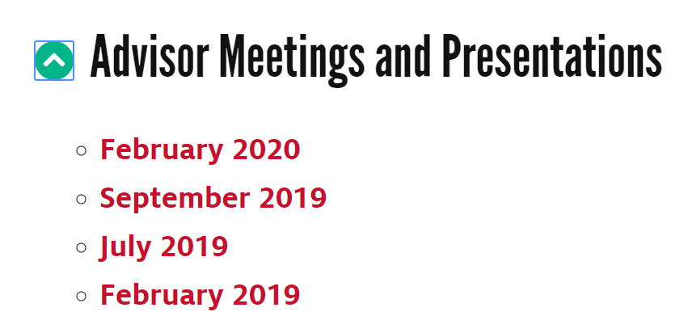
ACADEMIC AFFAIRS
Previous Grad Advisor Presentations
Amruta has worked very hard on keeping the website up to date and has added a link for Advisor Meetings and Presentations here. Advisor Meetings and Presentations
Notes:
New Staff/Transitional

Slide 5
Shawn Washington
Associate Director of Grad/Int’l Admissions.

Slide 6
Notes:
Below a screenshot of the application deadline change form that is located as a category in helpdesk request submission page here http://www.uh.edu/graduate-school/contact-us/ .
The category is located at the very bottom of the drop down menu under ‘UH Faculty and Staff Requests’.
The form ask for Program/Plan code, Application Type (Dom, Intl or Both) and whether they want to have the deadlines published on the UHGS website.

Slide 7
Special Admits Reminders:
GRE/GMAT – Test Score
Approval Signatures
Supporting Documents
Why is this applicant special?
Notes:
New Staff/Transitional

Slide 8
Duolingo Email

Slide 9
Priority Folder - CN
Fall 2020 application deadlines
- International transcript evaluations are tagged and completed based on deadline.
(If your program has a February deadline, we’ll work to complete all evaluations in February)
Priority folder is available for those applicants the department needs evaluated quickly.
- The transcript analyst team works to have priority evaluations done within 24 – 48 hours*
  (*24-48 hours after a PSID has populated in CN)
- Use for applications that are truly priority, when a high volume are pushed – we cannot complete the evaluations in 24 – 48 hours.
Notes:
New Staff/Transitional

Slide 10
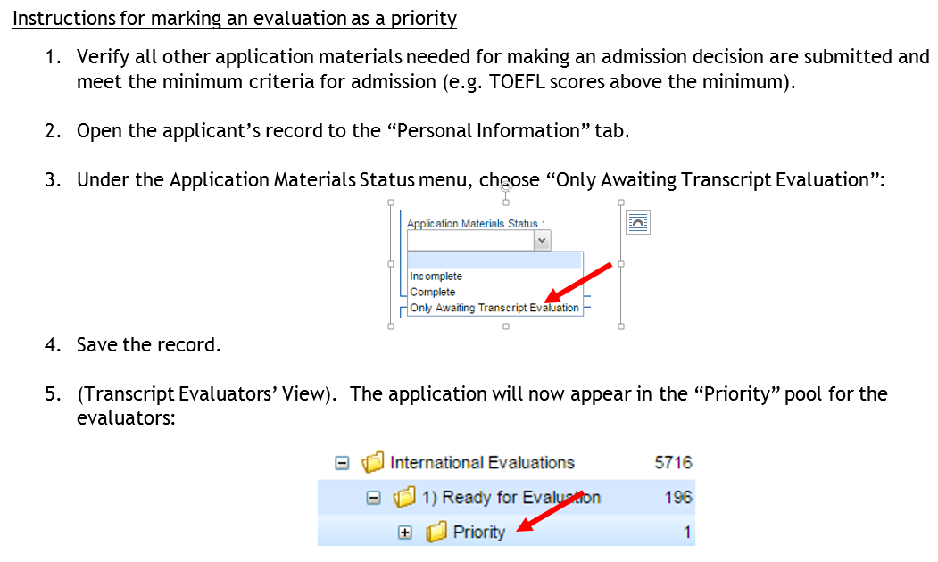
Priority Folder
Notes:
New Staff/Transitional

Slide 11

FA2020
http://www.uh.edu/ir/

Slide 12
Questions
Notes:
New Staff/Transitional

