Slide 1

Welcome!
GRAD ADVISOR ZOOM MEETING
7/23/2020
Graduate School & Campus Partners Updates & Reminders
Meeting will start shortly.

Slide 2

Tashemia Jones
Assistant Director, Academic Affairs Graduate School

Slide 3

Navigate is live
You should see the Navigate icon on your UH Access.
Dr. Pierson and I will discuss upcoming trainings for graduate advisors on 8/5. This information will be relayed to everyone.
Notes:
New Staff/Transitional

Slide 4
Shari Corprew
Director of Graduate School Dept.

Slide 5
PhD Admissions offer Letter review
Financial support amounts incorrect
No financial support indication
Decision letter needs correction
  CGS deadline
Needs release date
No decision letter
Sent to Registrar for residency review
Notes:
New Staff/Transitional

Slide 6
Auto-Generated email notifications
Subject: Decision Letter Approved Notification
This is to notify you that the decision letter for the following application has been approved.
Applicant Name
Program
Applicant ID

Slide 7
Auto-Generated email notifications
Subject: Admissions PhD Offer Letter Requires Attention
This is to notify you that the item(s) below for the following application needs to be corrected.
Comments: {a.("COMMENTS_GRADUATE_SCHOOL_DECISION")}
- Graduate School
Graduate School Approval for Decision Letter: {a.("GS_APPROVAL_DECISION_LETTER")}
Applicant Name: {a.("NAME_FIRST")} {a.("NAME_LAST")}
Program: {a.("UHOUSTON_PROGRAM_NAME")}
Applicant ID: {a.("EMPLID")}

Slide 8
Graduate and Professional Student Association (GPSA)
Encourage your students to participate in GPSA
Contact information
        Amy Barton (abarton@central.uh.edu)
        Erin Tomiyama (estomiya@central.uh.edu)
        https://uh.edu/graduate-school/gpsa/

Slide 9
Scholarships
Graduate Tuition Fellowship
Fall/Spring Processing
        Award Fall/Spring amounts in Fall
        Funds will not disburse until actively enrolled in required hours
        Deadlines
          Fall 2020
            Final: Friday, September 25, 2020
          Spring 2020
            Priority: Friday, December 4, 2020
            Final: Friday, February 19, 2021
      B70 (Payment Arrangement Complete) (aka: Positive Service Indicator)
        B70s will be added to all GTF recipient accounts before the fee bill deadline with an expiration date set after the 20th class day
        This positive service indicator will protect a student’s courses from being dropped. Therefore, a student does not need to enroll in a payment plan, unless they need to enroll in a payment plan for the portion of their fee bill they are responsible for.

Slide 10
Scholarships
GTF Fund Optimization Processing
        In order to optimize funding available, GTF awards that meet the qualifications for other funding sources, will be awarded GTF under a different name. This does not affect the student’s GTF award or their GTF amount. However, they will receive a communication from Financial Aid informing them of a change to their financial aid package.
          Example: A student was originally awarded GRADUATE TUITION FSHP (GTF). After end of year processing, new GTF awarded GTF-TPEG RES or GTF-SA, etc.

Slide 11
Scholarships
Academic Requirements
        All of the following must be met:
          From prior term
            9 hours completed
              IPs are ok
            3.0 cumulative GPA
              Anything less, student must submit a petition
          Disbursement
            9 hours enrolled
              Students can be enrolled in online classes, enrollment is audited not course delivery

Slide 12
Scholarships
FAFSA Requirement
        Requirement since Fall 2018
        If eligible to complete a FAFSA, student must have a complete FAFSA on file or GTF will not disburse or will be revoked until FAFSA is on file.
GTF College Policies
        All college policies are posted on the Graduate School website
          This link is included in the GTF communication that will be sent out to all GTF recipients every term
Award Revisions
        Adjustments for tuition, mandatory fees & waivers done by GS
        Can cover fees only if student is receiving another tuition waiver

Slide 13
Scholarships
In-State Tuition Waivers
        Competitive Scholarship (CS) waiver & TA/RA Employment waiver
          Use employment waiver first
          There is a cap on the number of CS waivers that can be awarded by the university
          The Graduate School will run an audit on GTF recipients with no waiver and notify the college
          Competitive Scholarship (CS) waiver requests must be submitted by the college in the GTF SharePoint
Employment
        RA/TE
          If student is a GTF recipient and employed as an RA, student must be employed in RA/TE position

Slide 14
Scholarships
Fee Bill Balances
        GTF covers:
          Tuition (Resident rate)
            Minimum of 9 credit hours, possibly more depending on college policies
          Out-of-state tuition through CS or TA/RA employment waiver
          Mandatory Fees
          Masters and certificates are the college’s responsibilities
          All other items are the responsibility of the student
            Pay these items by fee bill deadline or as soon as they are incurred

Slide 15
Scholarships
Refunds
        If GTF is posted for an amount higher than the student’s fee bill, a false credit will appear
          There are no refunds for GTF
          GTF is set-up in the system to cover tuition and mandatory fees only
        Only possible refund types:
          If student made a payment to their account
          Another scholarship/fellowship on their account
        Inform students to set-up refund preference

Slide 16
Scholarships
Audit
        Run at least 3 times a term
        Items audited
          GPA
          Enrollment
          Amounts
          No waivers
          Waiver, but no GTF
          RA, not in RA/TE job code
          Free Application for Federal Student Aid (FAFSA)
            If eligible to complete a FAFSA, student must have a complete FAFSA on file or GTF will not disburse or will be revoked until FAFSA is on file.

Slide 17
Scholarships
GTF SharePoint
        If you would like an option added for your college, email us the language and we’ll get it added
        Reminder: Do not delete any records and do not make any edits in the section titled Graduate School

Slide 18
Scholarships
Graduate School Fund
Audit
        Texas resident
        FAFSA
        Financial need
        Enrolled in a minimum of 6 credit hours during Fall and Spring
          Prorated amounts when less than full-time
        Demonstrate Satisfactory Academic Progress
        Not be a recipient of GTF

Slide 19
Scholarships
Presidential Fellowship
Audit
        FAFSA (Domestic Students)
        Full-Time Enrollment
          Enroll and complete a minimum of nine (9) credit hours during an academic term
        Maintain a 3.0 cumulative GPA
        Demonstrate Satisfactory Academic Progress

Slide 20
Assistantships
Domestic graduate students can be hired in an assistantship position while not physically at the University as long as the job function can be performed remotely and the student is approved for remote work
Graduate Student Assistantships (GR-SOP-Finance-03)
        https://uh.edu/graduate-school/forms/
          Policies and Procedures, 3. a.
            Overload requests are not required for winter mini session or summer appointments
              Summer appointments include those from May 1 to August 31
              Winter mini appointments include those from December 1 to January 31

Slide 21
Assistantships
For all of assistantship policies visit Conditions of Service
        http://publications.uh.edu/content.php?catoid=33&navoid=12001
Audit
        A student with an application to graduate on file cannot work past the official closing date of the session
          Fall 2020 official closing of the session is Wednesday December 16, 2020
        GPA and completed hours for academic college
        Employed and not enrolled
        Graduate student employed in Academic Support Assistant (UGRD)

Slide 22
Mariel Rocha-Narvaez
Program Manager I, Finance/Operations Dept.

Slide 23
Non-Resident Tuition Employment Waiver
Fall 2020 final deadline is Friday, September 4, 2020
FY21 TA/RA Waiver rate is $509/hour
Check the SharePoint TA/RA Waiver to make sure you are not submitting a duplicate request
Student is employed at least .50 Full-Time Equivalent (FTE)
Student is employed in one of the following graduate student job titles: Research Assistant – Tuition Eligible (RA/TE), Research Assistant (RA), Teaching Assistant (TA), Teaching Fellow (TF), Industrial Assistant (IA)
Make sure student is employed on or before ORD
        Official Reporting Day (ORD) is September 9, 2020

Slide 24
Application Fee Waivers
Effective August 1, 2020 all application fees will be structured
        Domestic Application Fee: $50
        International Application Fee: $80
        Non-degree objective application fee (both domestic/international): $25
Request fee waivers directly in the CollegeNET graduate application and submit supporting documentation
        McNair Scholars
Graduate School events
        Graduate School Fair and Virtual Info Sessions
The college/program requests application fee waiver codes from the Graduate School via email to gradschool@uh.edu
        Requests must be approved by the College’s Associate Dean for Graduate Studies or by the College’s Business Office

Slide 25
UH Life Hacks
The Graduate School created a document with helpful tips for incoming students
https://uh.edu/graduate-school/admissions/admitted-students/
Notes:
New Staff/Transitional

Slide 26
Shawn Washington
Associate Director of Grad/Int’l Admissions.

Slide 27
International Student Check-Ins
Tentative Dates:
August 5th - 6th,
*Aug 12th – 13th,
*19th -20th,
*26th – 27th
E. Cullen Building, Rm#102
Appointments Only
Walk-ins/Drop-off their admission documents
Virtual Meetings
* Will need to reconfirm.
Notes:
New Staff/Transitional

Slide 28
Reminders FOR Deferral Requests
Petition is needed for any students “matriculated” in PS for FA2020.
No deferments processed after ORD (Sept 9th).
http://publications.uh.edu/content.php?catoid=33&navoid=12203
Graduate School Policy – New students can defer their admission up to two future terms.
However, no deferments can be processed for the FA2021 term until PS has been updated (August 1st)

Slide 29
Hard-copied Mail
Mail is picked up each week
Domestic applicants should request a electronic copy of their transcripts.
Forward any inquiries or questions to gradschool@uh.edu

Slide 30
Fall 2021 Recruitment Cycle
The Fall 2021 admission applications will open (Aug 1st), so remember to review program descriptions and test –the applications of your programs.
New Application Fees (Aug 1st):
Domestic $50,
International $80
Non-degree/certificate $25

Slide 31
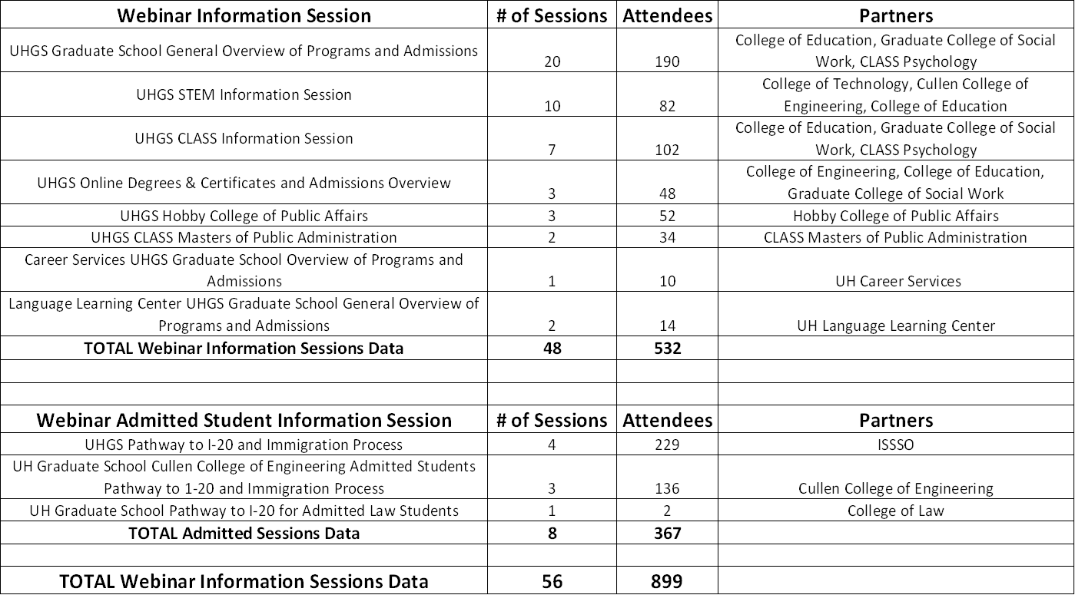
Information Sessions Updates
Notes:
New Staff/Transitional

Slide 32
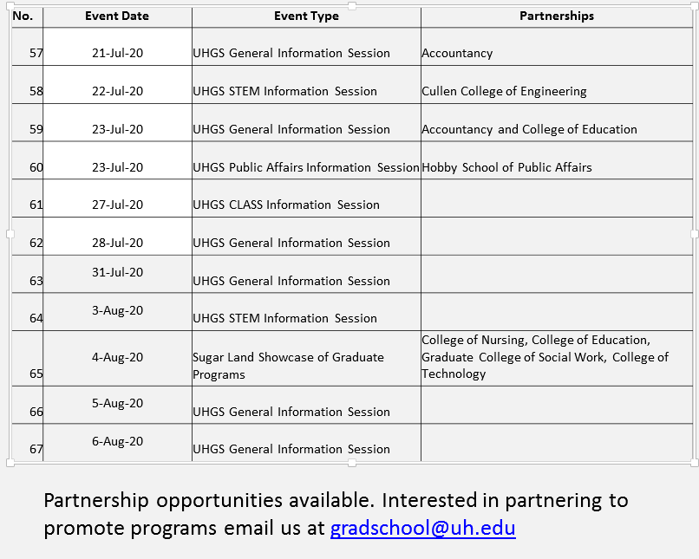
Future Sessions

Slide 33
Decision “Offer” Letter Reminders
Remember decision letters are released from CollegeNET to the applicant’s ApplyWeb account.
There’s no direct email going to an Applicant’s inbox.
Inform Applicants to log back into their ApplyWeb accounts to view and accept their offer letter.
Notes:
New Staff/Transitional

Slide 34
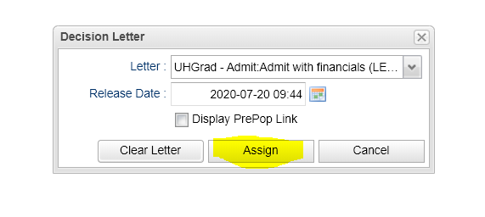
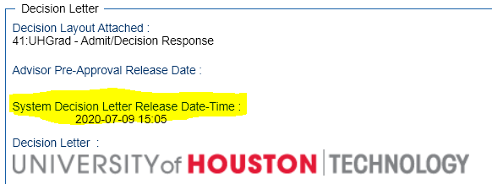
Decision Letter Release Date
Notes:
New Staff/Transitional

Slide 35
I-20 processing
Christen Gould
SEVIS Compliance Coordinator

Slide 36
Students Attending Online for Fall 2020
Students can attend courses online without an I-20 if they are outside the United States.
  Online enrollment does not require an I-20
  Online enrollment can be utilized if the student cannot get a visa or a visa appointment so the student can begin their course of study

Slide 37
I-20 for Spring 2021
If your student is attending online for Fall 2020, and wishes to get a visa for Spring 2021
  Please place the name, PSID and program on an excel spreadsheet and send it to cpowers6@uh.edu
  The I-20 issued for Spring 2021 will need to mention online enrollment for Fall 2020
Notes:
New Staff/Transitional

Slide 38
Deferments to Spring 2021
Traditional deferment of admission to Spring 2021 will be handled in the same fashion as always
  Submit petition to change the admission semester to Spring 2021, and then update the application semester in CollegeNet
  These students will receive a new I-20 for initial attendance for Spring 2021
  Spring 2021 documents will begin processing on August 1

Slide 39
Deferments to Fall 2021
Traditional deferments to Fall 2021 will be processed the same way as Spring 2021 deferments
  Submit petition to change admission semester to Fall 2021, and update the application semester in CollegeNet.
  These students will receive a new I-20 for initial attendance for Fall 2021
  Fall 2021 documents will begin being sent out in February 2021.

Slide 40
Transfer and Change of Degree Level
Students that are already here in the United States can receive an I-20 for continued attendance for Fall 2020.
If these students wish to enroll online, they can; however one hybrid, or face to face course is highly recommended.
Currently, SEVP guidelines permit enrollment in more online hours than formerly allowed. Please follow up with OISSS or myself if you have questions regarding required enrollment levels.

Slide 41
Chastyne Blalock
Executive Assistant to Dr. Larsen & Events Coordinator

Slide 42
Below are our upcoming events:
August 18th - Graduate Orientation Webinar
* Morning session 9:00a – 10:30a
* Afternoon session 1:30p – 3:00p
Notes:
New Staff/Transitional

Slide 43
Jay Hills
Assistant Registrar
Office of the University Registrar

Slide 44
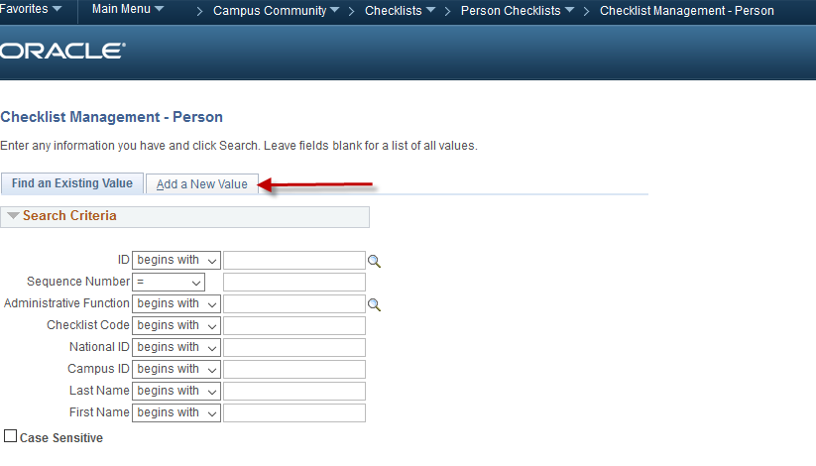
CREATE Checklist
Campus Community > Checklist > Person Checklist > Checklist Management Person
Notes:
New Staff/Transitional

Slide 45
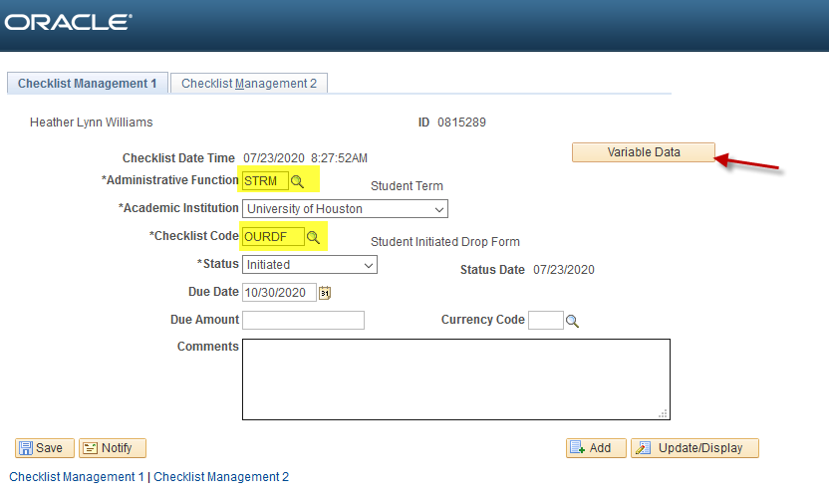
Administrative Function: STRM
Checklist Code: OURDF
Notes:
New Staff/Transitional

Slide 46
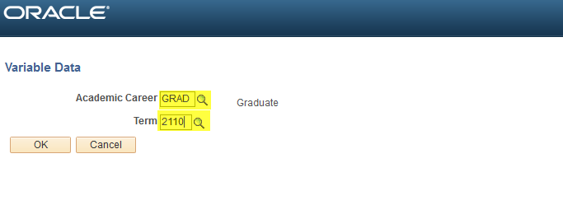
Variable Data
Notes:
New Staff/Transitional

Slide 47
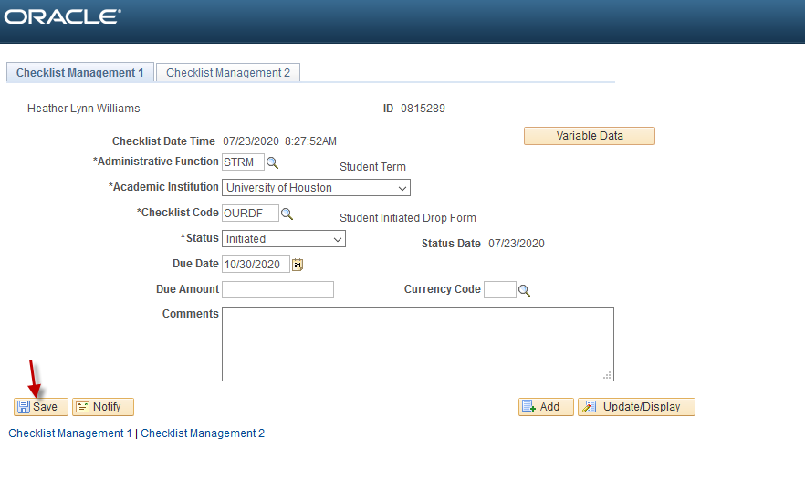
Notes:
New Staff/Transitional

Slide 48
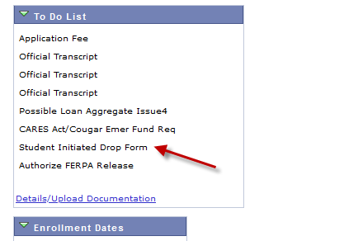
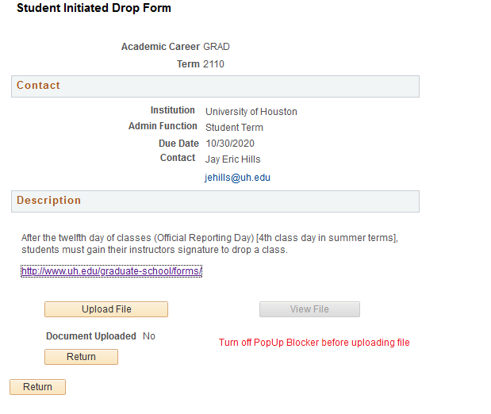
Notes:
New Staff/Transitional

Slide 49
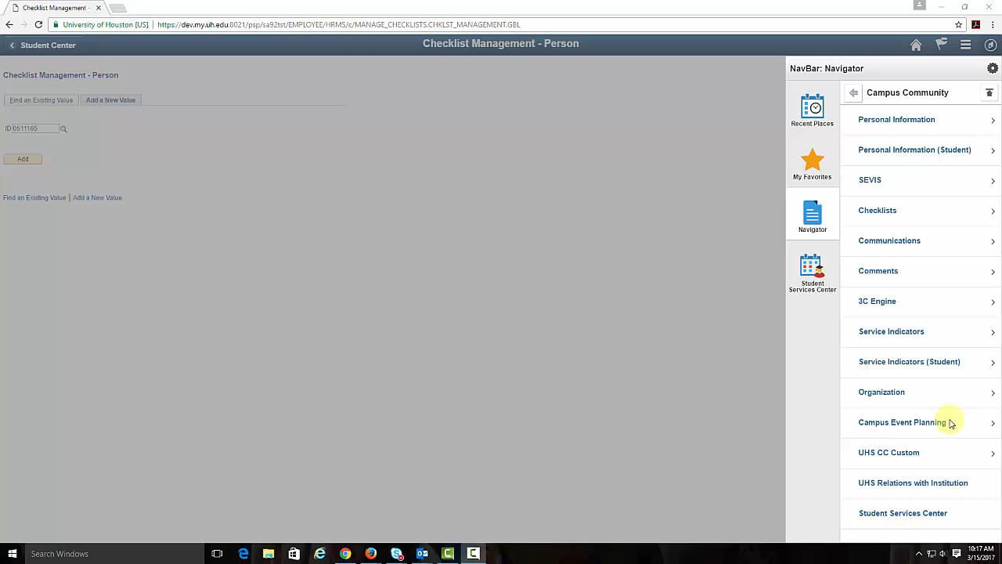
Notes:
New Staff/Transitional

Slide 50
Stefan Johnsson
SEVIS Compliance Sr. Coord.
International Student and Scholar Services Office
If you have questions for ISSSO please contact Stefan directly.
sjohnsso@Central.UH.EDU

