Slide 1

Welcome!
News, Updates & Reminders
Graduate School Department

Slide 2
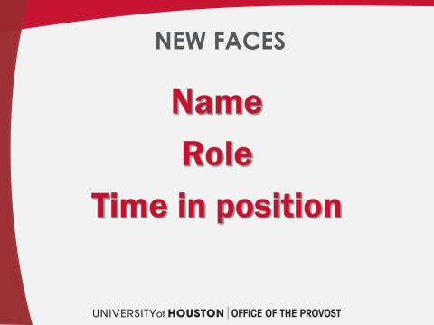
Notes:
New Staff/Transitional

Slide 3

Dr. Sarah Larsen
Vice Provost and Dean of the Graduate School Dept.

Slide 4

July 25, 2019
UH Student Center Theater
6:00 PM – 7:00 PM
The UH Graduate School and the Division of Research Presents:
“Surviving Your Stupid, Stupid Decision to Go to Graduate School”
Starring Adam Ruben
Adam Ruben is a writer, comedian, storyteller and molecular biologist. He is the author of Surviving Your Stupid, Stupid Decision to Go to Grad School, a satirical guide to the low points, as, well, lower points of post-baccalaureate education.
This one-man show offers up cheeky commentary on how to survive and thrive as a grad student.
RSVP to attend this FREE event at www.Eventbrite.com
FREE FREE FREE

Slide 5
Shari Corprew
Director of Graduate School Dept.

Slide 6
Scholarships
GTF
GATF Audit Report Path (Campus Solutions/PeopleSoft)
        Main Menu\Records and Enrollment\UHS SR Custom\SR Reports\UHS GATF Audit Report
          Academic Institution: 00730
          Term: XXXX (Fall 2019=2090, each term number increases in increments of 10)
          Students Selection Options:
            Exclude UGRD students
Summer Processing
        Must be enrolled before award request is processed and sent to Financial Aid
Notes:
New Staff/Transitional

Slide 7
Scholarships
Fall/Spring Processing
        Award Fall/Spring amounts in Fall
        Funds will not disburse until actively enrolled in required hours
        Deadlines
          Fall 2019
            Priority: Thursday, May 30, 2019
            Final: Friday, September 27, 2019
          Spring 2020
            Priority: Friday, December 6, 2019
            Final: Friday, February 21, 2020
      B70 (Payment Arrangement Complete) (aka: Positive Service Indicator)
        B70s will be added to all GTF recipient accounts before the fee bill deadline with an expiration date set after the 20th class day
        This positive service indicator will protect a student’s courses from being dropped. Therefore, a student does not need to enroll in a payment plan, unless they need to enroll in a payment plan for the portion of their fee bill they are responsible for.

Slide 8
Scholarships
GTF Fund Optimization Processing
        In order to optimize funding available, GTF awards that meet the qualifications for other funding sources, will be awarded GTF under a different name. This does not affect the student’s GTF award or their GTF amount. However, they will receive a communication from Financial Aid informing them of a change to their financial aid package.
          Example: A student was originally awarded GRADUATE TUITION FSHP (GTF). After end of year processing, new GTF awarded GTF-TPEG RES or GTF-SA, etc.

Slide 9
Scholarships
Academic Requirements
        All of the following must be met:
          From prior term
            9 hours completed
              IPs are ok
            3.0 cumulative GPA
              Anything less, student must submit a petition
          Disbursement
            9 hours enrolled

Slide 10
Scholarships
FAFSA Requirement
        New requirement starting Fall 2018
GTF College Policies
        All college policies are posted on the Graduate School website
          This link is included in the GTF communication that will be sent out to all GTF recipients every term
Award Revisions
        Adjustments for tuition, mandatory fees & waivers done by GS
        Can cover fees only if student is receiving another tuition waiver

Slide 11
Scholarships
In-State Tuition Waivers
        Competitive Scholarship (CS) waiver & TA/RA Employment waiver
          Use employment waiver first
          There is a cap on the number of CS waivers that can be awarded by the university
          The Graduate School will run an audit on GTF recipients with no waiver and notify the college
          Competitive Scholarship (CS) waiver requests must be submitted by the college in the GTF SharePoint
Employment
        RA/TE
          If student is a GTF recipient and employed as an RA, student must be employed in RA/TE position

Slide 12
Scholarships
Fee Bill Balances
        GTF covers:
          Tuition (Resident rate)
            Minimum of 9 credit hours, possibly more depending on college policies
          Out-of-state tuition through CS or TA/RA employment waiver
          Mandatory Fees
          All other items are the responsibility of the student
            Pay these items by fee bill deadline or as soon as they are incurred

Slide 13
Scholarships
Refunds
        If GTF is posted for an amount higher than the student’s fee bill, a false credit will appear
          There are no refunds for GTF
          GTF is set-up in the system to cover tuition and mandatory fees only
        Only possible refund types:
          If student made a payment to their account
          Another scholarship/fellowship on their account
        Inform students to set-up refund preference

Slide 14
Scholarships
Audit
        Run at least 3 times a term
        Items audited
          GPA
          Enrollment
          Amounts
          No waivers
          Waiver, but no GTF
          RA, not in RA/TE job code
          Free Application for Federal Student Aid (FAFSA)

Slide 15
Scholarships
GTF SharePoint
        New GTF Hours column
          If you would like an option added for your college, email us the language and we’ll get it added
        Reminder: Do not delete any records and do not make any edits in the section titled Graduate School
        If eligible to complete a FAFSA, student must have a complete FAFSA on file or GTF will not disburse or will be revoked until FAFSA is on file.

Slide 16
Scholarships
Advisor Questions
        Financial Aid Satisfactory Academic Progress (SAP) and Graduate Tuition Fellowship (GTF)/Graduate School Fund (GSF)
        Can there be one place to verify GTF and Waiver submissions? (Currently we have to go to 2 SharePoints and SAM)
        Can someone send an email to the financial office to let them know there are students receiving GTF and the money has not posted. When the students get this they get frantic.

Slide 17

Tashemia V. Jones, Ed.D.
Assistant Director of Programs/Student Records

Slide 18
Beginning of term reminders
ORD is September 4th-Take care of these before!
  Enrollment corrections after ORD are becoming more regular. If it does not prevent graduation other solutions will be pursued. Simply forgetting to enroll is not justification
  Are all first-semester students enrolled?
    Check the class roster for any standard first semester courses
    MAIN MENU>CURRICULUM MANAGEMENT>CLASS ROSTER
  Are all 2nd year (plus) students admitted unconditionally? No students should remain on conditional status when returning for their second year
  Ensure all returning students enroll, or on approved LOA if not, communicate and if needed, discontinue.
Notes:
New Staff/Transitional

Slide 19
Friendly reminders
Are all candidates in research/thesis/dissertation sections with the correct number and professor?
Have you provided the students a clear set of expectations/explanations of the roles of the graduate advisor and graduate student?
Per OUR- please discard all previous versions of the Inter-Institution Registration Form you may have online or in their offices. I will forward you a copy along with the slides
Degree completion course is used ONLY for IP or a student did not apply to graduate on time. The Degree Completion course CANNOT be used to complete unfinished thesis or dissertation work. (students should also check with their departments’ policy on this)

Slide 20
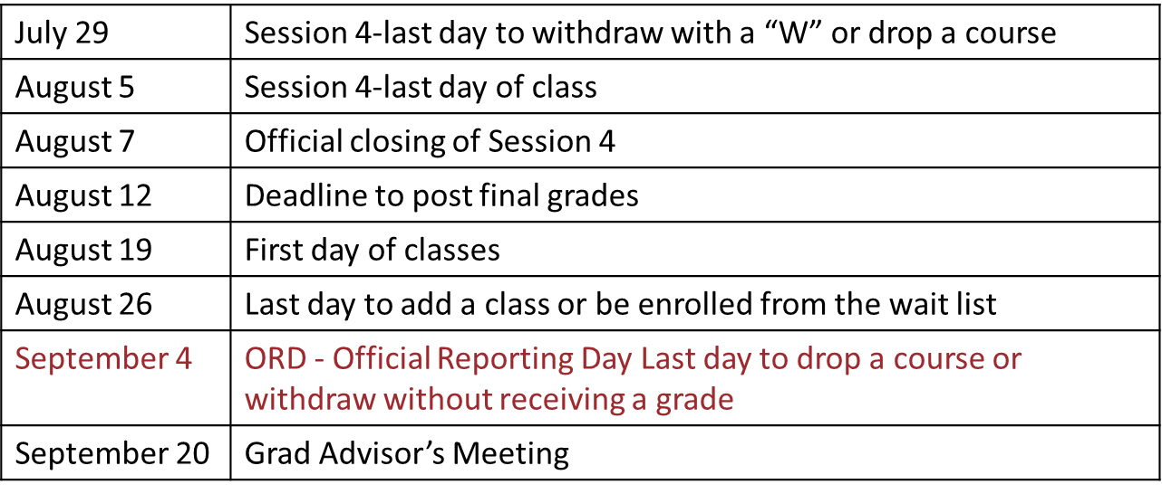
Important dates & Queries
Useful Queries
UHGS_ROSTER_BY_DEPT
Department query, only grads, less columns
UHIR_MAJORS_ROSTER_BY_DEPT
Department query, all students, all columns
UHIR_ENROLLMENT_BY_DEPT_GRAD
All course enrollments/drops by grad students, by department, be sure to note ENRL vs DROP
UHM_CLASS_ENROL_TOTALS_CLASS
How many were enrolled in each class, easy way to find extra sections with zero enrollment that can go

Slide 21
Shawn Washington
Assistant Director of Grad/Int’l Admissions.

Slide 22
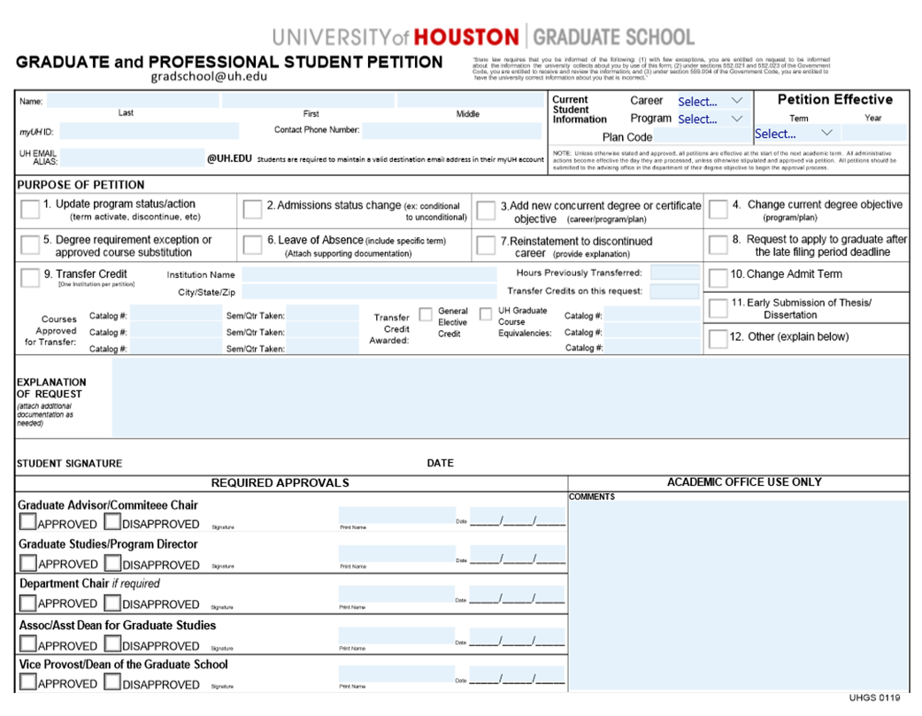
Notes:
New Staff/Transitional

Slide 23
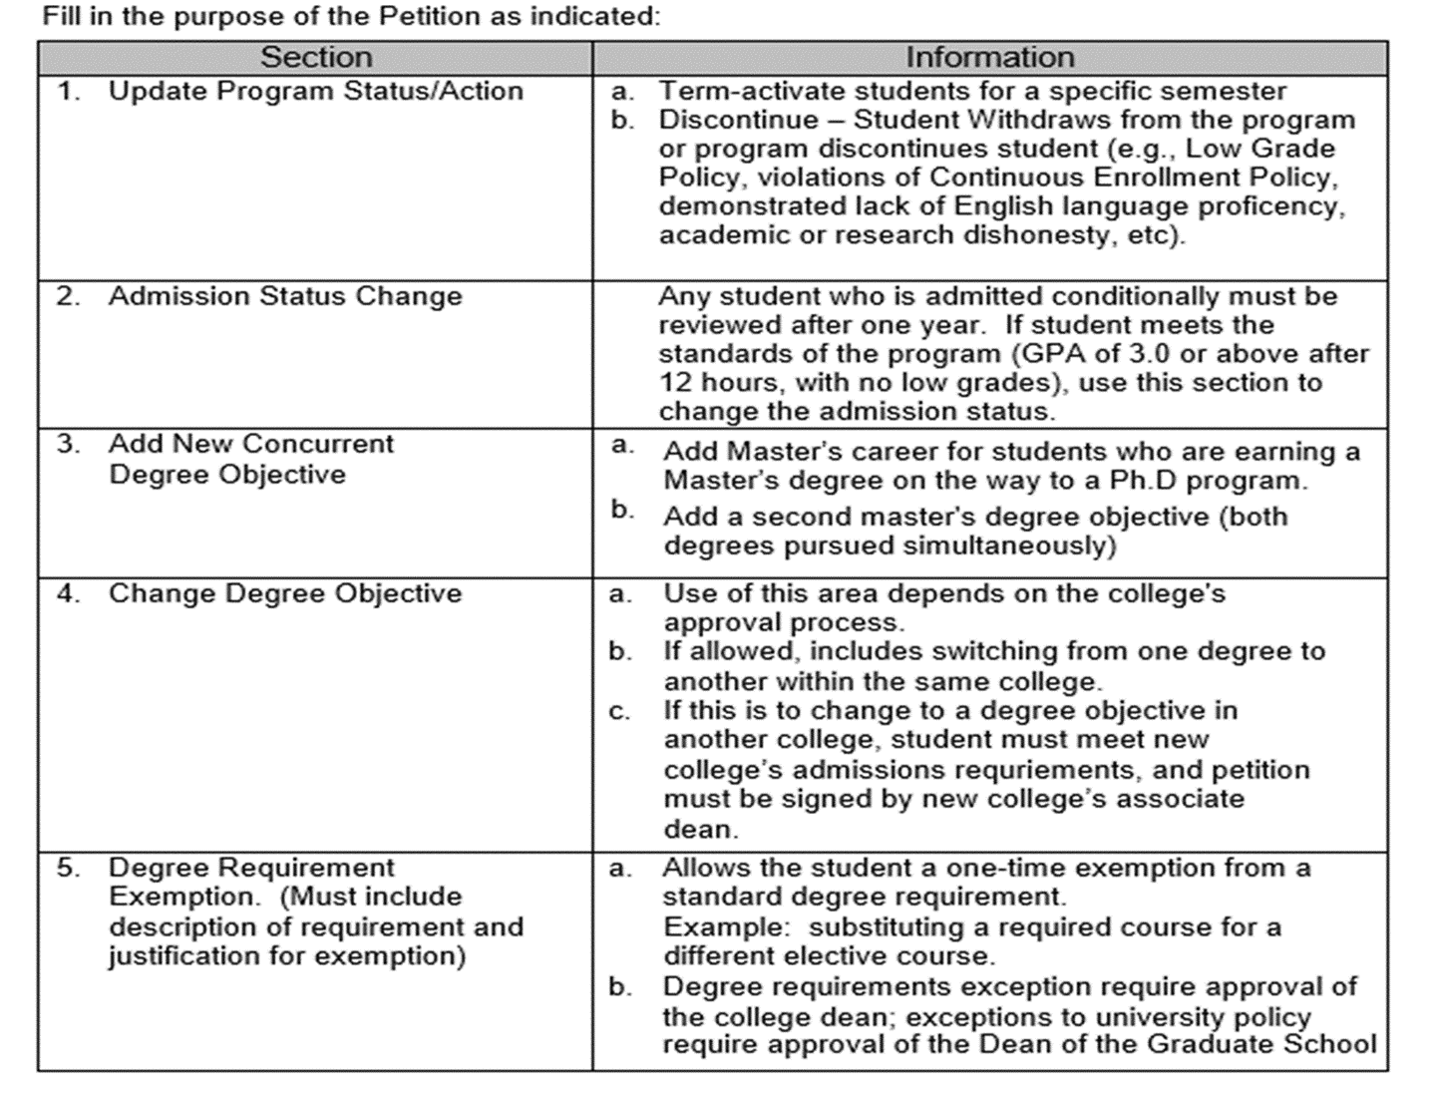
Notes:
New Staff/Transitional

Slide 24
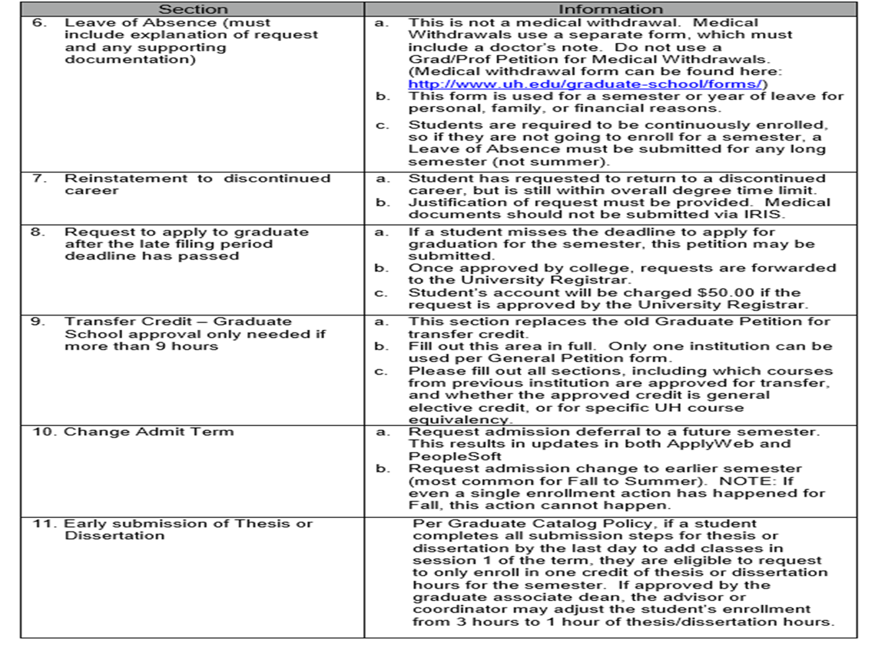

Slide 25
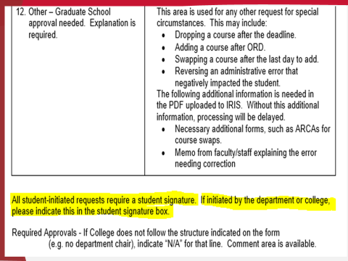

Slide 26
rEMINDERS
August 1: Summer/Fall 2020 App opens. Remember to verify that the correct programs are open and program descriptions.
Annual Changes
Census Day (ORD) is Sept 4th
Incomplete App’s from SU2019 terms

Slide 27
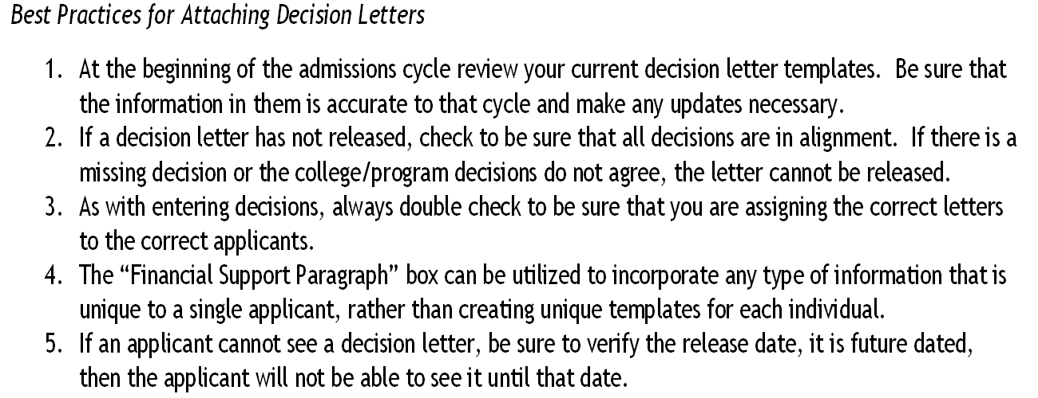
Best Practices

Slide 28
Best practices
Best Practices Regarding International Transcript Evaluations
Always use the evaluations as a reference during the admissions process to ensure that you are offering admission only to applicants who meet our admissibility standards. Also, use the other information provided so that you have knowledge of the applicant’s academic background.
Reference the evaluator’s comments and the Graduate School’s website to answer newly admitted students’ questions about what materials are needed.
Do not receive transcript materials in your office, also route walk in applicants or mailed transcript documents directly to the Graduate School. Never open a transcript in your office.
Use the “Priority” requests strategically in order to make admission offers to the best candidates early.
Do not offer admission until a transcript evaluation has been completed; this will prevent offering admission to applicants who do not qualify for graduate study in the United States.

Slide 29
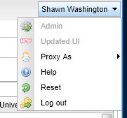
CN Online Tutorials
http://awdocs.applyweb.com/admithelp/tutorials/ADMIT_assign_decision/ADMIT_assign_decision.htm

Slide 30
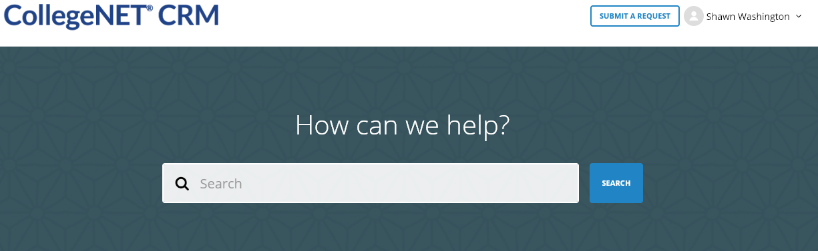

Slide 31
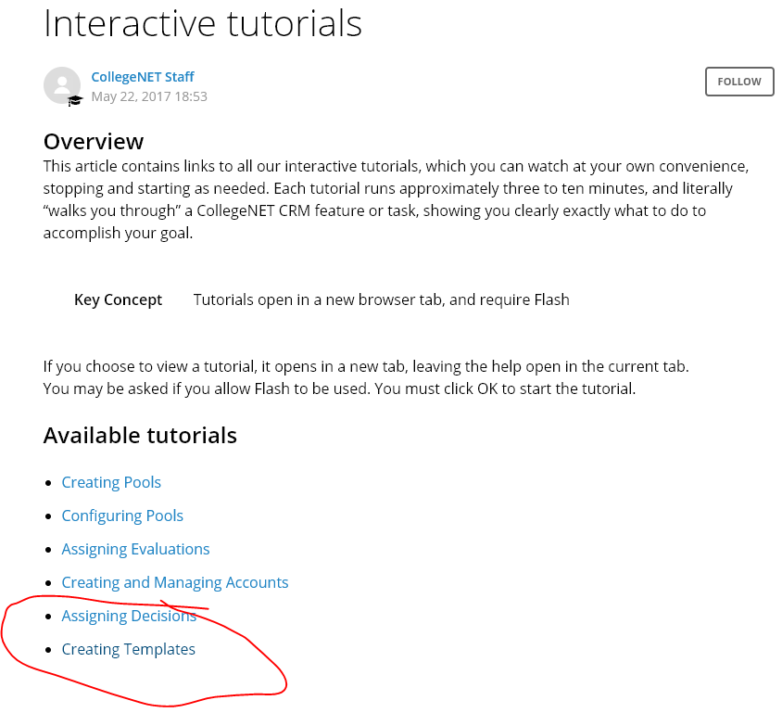

Slide 32
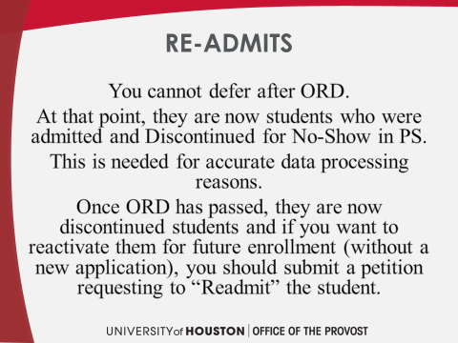

Slide 33

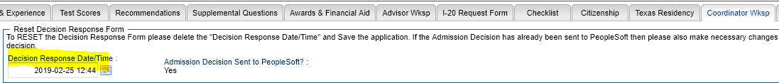
Coordinator Wksp

Slide 34
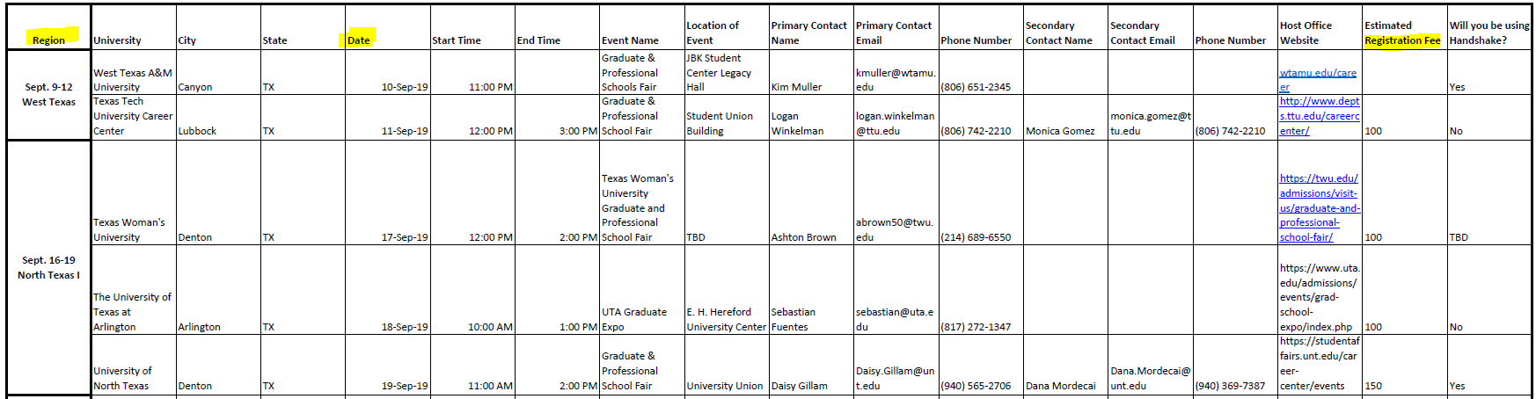
2019 Texas Swing

Slide 35
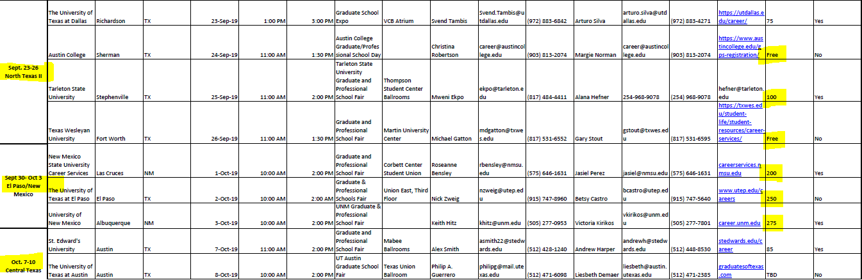
TX-Swing
Notes:
New Staff/Transitional

Slide 36
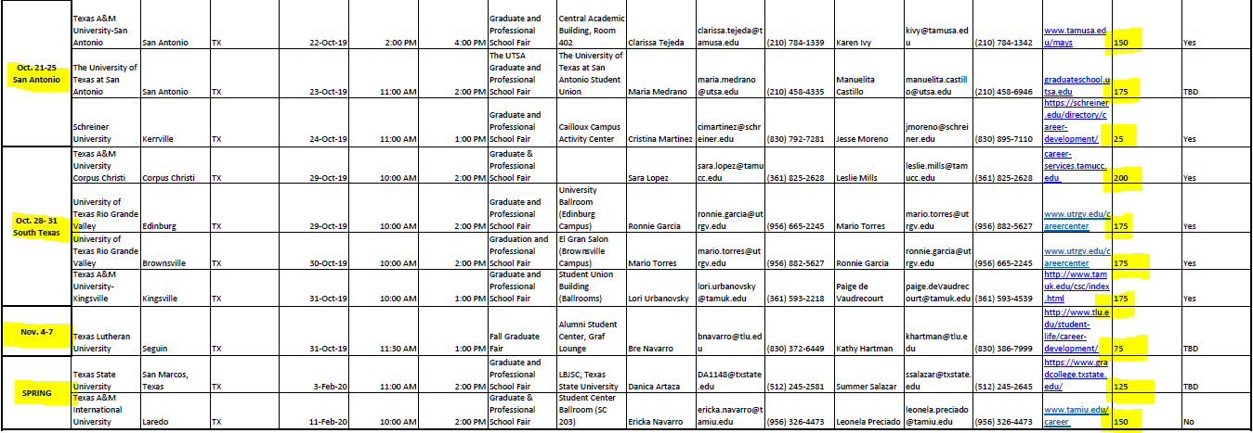
swing

Slide 37
I-20 processing
Christen Gould
SEVIS Compliance Coordinator

Slide 38
Spring 2020 Processing
All documents must be received before the I-20 can be processed
  Ensure all documents have been received before submitting the I-20 request
  Requests that are missing documents in Applyweb
    There is no automatic notifications when a document is uploaded.
      Notification must be manually sent.
Notes:
New Staff/Transitional

Slide 39
Accepted Offer
The student must accept the offer of admission before the I-20 request submits
  The date on the I-20 request is the date the advisor submits request, however, it does not show up in processing queue until after the offer is accepted.

Slide 40
Shipping of the I-20
Shipping of the I-20
  Will be managed by the Graduate School
  Will be available via E-ship global
  Will be directly arranged with the student

Slide 41
Scanning and Copying I-20
Homeland security does not recommend scanning the signed official I-20 to students.
  Email is not a secure method of sending information
  The scanned copy does can not be substituted for the original.

Slide 42
Scanning and Copying I-20
Hard copies of the I-20 should not be made or retained.
  Students are required to keep their original, signed I-20 with them at all times. A photocopy of the I-20 cannot be substituted for the original.
  If lost or misplaced, a new I-20 must be issued by OISSS
  The student cannot cross the border of the United States, with a photocopy of the I-20.

Slide 43
Scanning and Copying I-20
If the department wishes to keep a copy of the I-20, an unsigned draft is kept on file by the Graduate School.
  Please request I-20 drafts by emailing gradschool@uh.edu

Slide 44
Chastyne Blalock
Executive Assistant to
Dr. Larsen & Events Coordinator

Slide 45

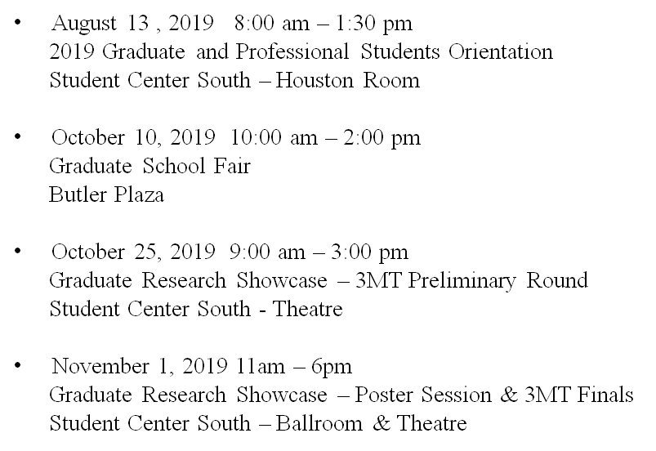

Slide 46


