Slide 1

Welcome!
News, Updates & Reminders
FEBRUARY 25, 2020

Slide 2
New Faces
Name
Role
Time in position
Notes:
New Staff/Transitional

Slide 3

Dr. Sarah Larsen
Vice Provost and Dean, Graduate School

Slide 4
Stefan Johnsson
Coord, Sr, SEVIS Compliance
ISSSO

Slide 5
Curtis Wallace
Assistant Registrar,
Office of the University Registrar

Slide 6
Shari Corprew
Director, Graduate School

Slide 7
PhD Admissions offer Letter review
Financial support amounts incorrect
No financial support indication
Decision letter needs correction
  CGS deadline
Needs release date
No decision letter
Sent to Registrar for residency review
Notes:
New Staff/Transitional

Slide 8
Auto-Generated email notifications
Subject: Decision Letter Approved Notification
This is to notify you that the decision letter for the following application has been approved.
Applicant Name
Program
Applicant ID

Slide 9
Auto-Generated email notifications
Subject: Admissions PhD Offer Letter Requires Attention
This is to notify you that the item(s) below for the following application needs to be corrected.
Comments: {a.("COMMENTS_GRADUATE_SCHOOL_DECISION")}
- Graduate School
Graduate School Approval for Decision Letter: {a.("GS_APPROVAL_DECISION_LETTER")}
Applicant Name: {a.("NAME_FIRST")} {a.("NAME_LAST")}
Program: {a.("UHOUSTON_PROGRAM_NAME")}
Applicant ID: {a.("EMPLID")}

Slide 10
Mariel Rocha-Narvaez
Program Manager I, Finance/Operations Dept.

Slide 11
Graduate School Fund
Items audited
        Texas resident
        FAFSA
        Financial need
        Enrolled in a minimum of 6 credit hours during Fall and Spring
          Prorated amounts when less than full-time
          Enrollment exception during graduating semester
        Demonstrate Satisfactory Academic Progress
        Not be a recipient of GTF

Slide 12
Graduate Tuition Fellowship
Items audited
        Amounts
        No waivers
        Waiver, but no GTF
        RA, not in RA/TE job code
        Free Application for Federal Student Aid (FAFSA)
          If eligible to complete a FAFSA, student must have a complete FAFSA on file or GTF will not disburse or will be revoked until FAFSA is on file.
Notes:
New Staff/Transitional

Slide 13
Non-Resident Tuition Employment Waiver
Summer 2020 final deadline
        Summer Mini is Monday, May 11, 2020
        Session 1-3 is Tuesday, June 2, 2020
        Session 4 is Tuesday, July 7, 2020
Check the SharePoint TA/RA Waiver to make sure you are not submitting a duplicate request
Student is employed at least .50 Full-Time Equivalent (FTE)
Student is employed in one of the following graduate student job titles: Research Assistant – Tuition Eligible (RA/TE), Research Assistant (RA), Teaching Assistant (TA), Teaching Fellow (TF), Industrial Assistant (IA)
Make sure student is employed on or before ORD
        Official Reporting Day (ORD)
          Summer Mini is Wednesday, May 13, 2020
          Session 1-3 is Thursday, June 4, 2020
          Session 4 is Thursday, July 9, 2020

Slide 14
Assistantships
Items Audited
        A student with an application to graduate on file cannot work past the official closing date of the session
          Spring 2020 official closing of the session is Tuesday, May 6, 2020
        GPA and completed hours for academic college
        Employed and not enrolled
        Graduate student employed in Academic Support Assistant (UGRD)

Slide 15
Application Fee Waivers
All application fee waiver requests must come from the College Dean’s or Business Office
        An approval email from one of these offices can be included in the waiver code request email

Slide 16

Tashemia V. Jones, Ed.D.
Assistant Director, Academic Affairs

Slide 17
Reminders/Updates
Spring 20 Dissertation Accelerator scheduled for May 11-14th
  Applications will open April 1st and will be open to all colleges. Seats will be limited.
Apply to graduate LATE filing Period 2/22-3/20
Last day to withdraw with a “w” 4/2
Deadline to post grades 5/11
Please visit the academic calendar for more dates and details
Notes:
New Staff/Transitional

Slide 18
Policy revision
GPSC 9481R3 19F – In Progress (IP)
Students have graduated with IP grades on their transcripts
students with an IP may not be receiving sufficient feedback on their academic progress
IP grades remaining on the final transcript
Fall 2020 thesis/dissertation courses to be graded either by S/U or letter grades and would not allow the use of IP grades.
Notes:
New Staff/Transitional

Slide 19
Shawn Washington
Associate Director, Grad/Int’l Admissions

Slide 20
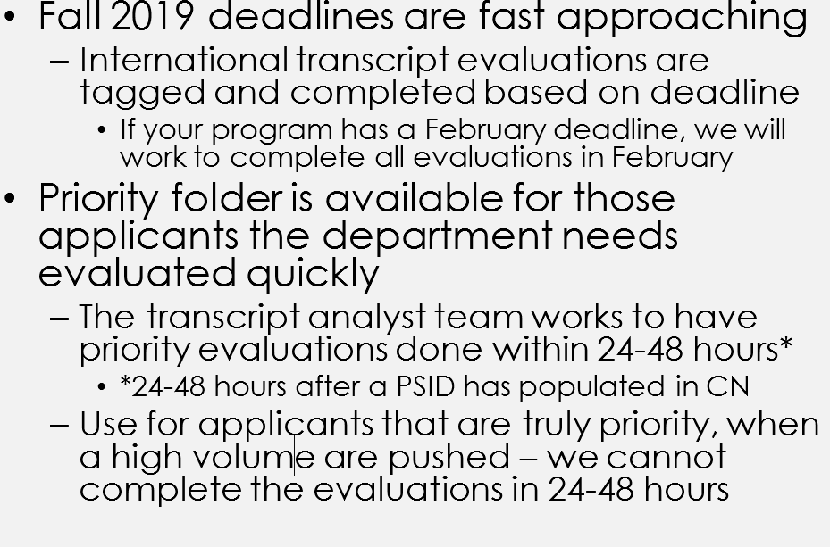
Priority folder - CN

Slide 21
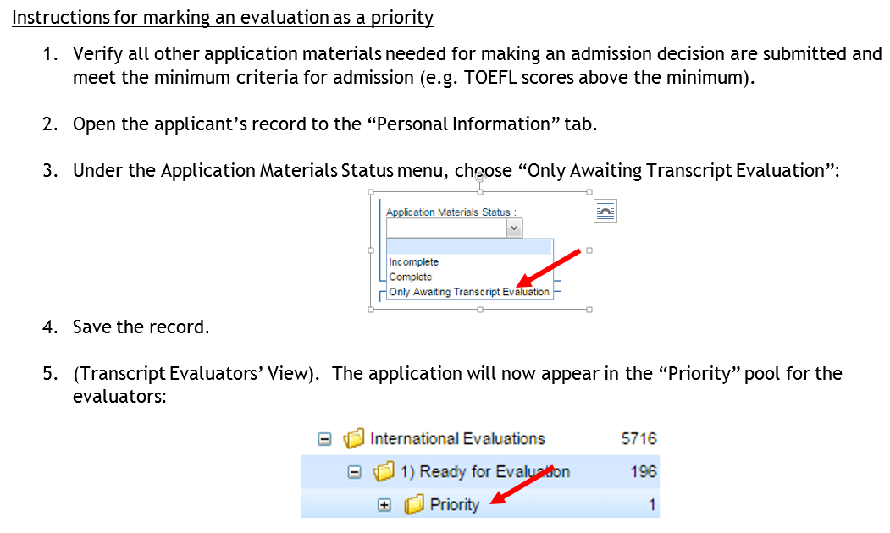
Priority Folder
Notes:
New Staff/Transitional

Slide 22
Best Practices:
Always use the evaluations as a reference during the admissions process to ensure that you are offering admission only to applicants who meet our admissibility standards. Also, use the other information provided so that you have knowledge of the applicant’s academic background.
Reference the evaluator’s comments and the Graduate School’s website to answer newly admitted students’ questions about what materials are needed.
Do not receive transcript materials in your office, also route walk in applicants or mailed transcript documents directly to the Graduate School Dept. Never open a transcript in your office.
Use the “Priority” requests strategically in order to make admission offers to the best candidates early.
Do not offer admission until a transcript evaluation has been completed; this will prevent offering admission to applicants who do not qualify for graduate study in the United States.
Notes:
New Staff/Transitional

Slide 23
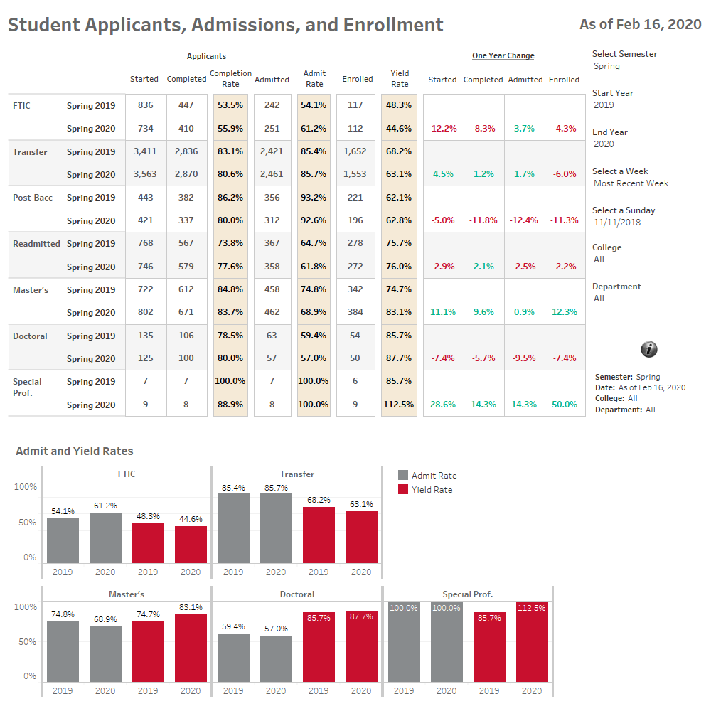
SP2020
http://www.uh.edu/ir/

Slide 24
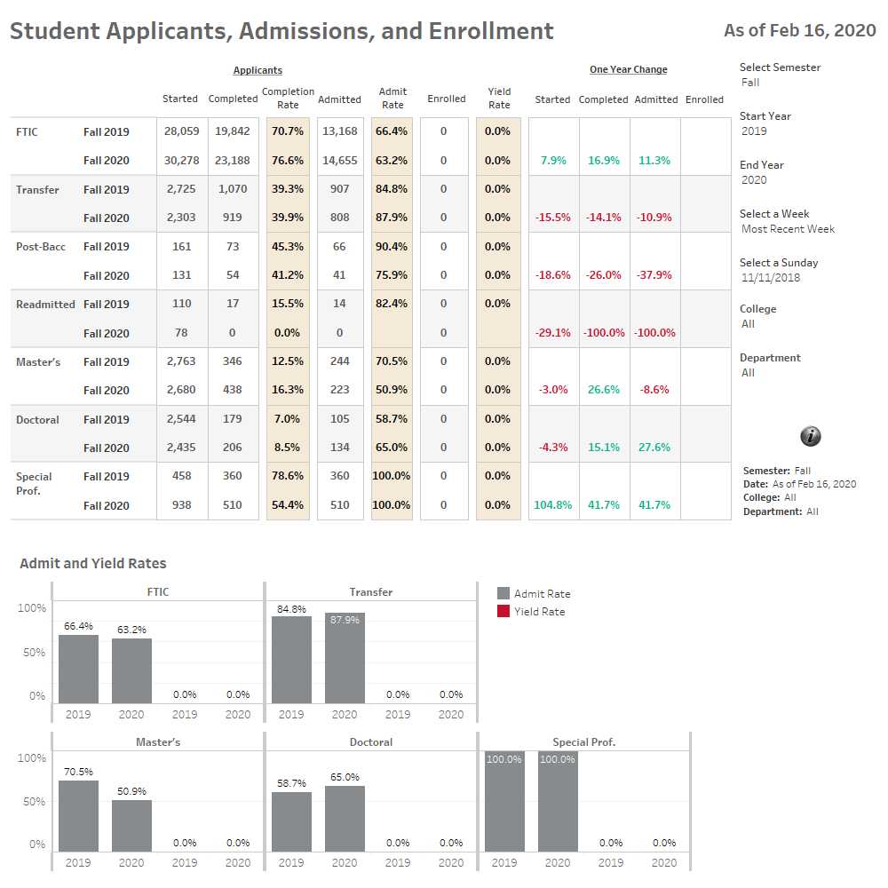
FA2020
http://www.uh.edu/ir/

Slide 25
“After seeing declines in international graduate applications over two consecutive admission cycles, the U.S. institutions in the CGS International Graduate Admissions Survey reported increases in both applications and first-time enrollment of international graduate students.”
“Overall One-year Changes. The total number of international graduate applications received by U.S. degree-granting institutions participating in the CGS International Graduate Admissions Survey (N = 210) increased by 3% between Fall 2018 and Fall 2019, and the total first-time graduate enrollment rose by 4%”
International Graduate Applications and Enrollment Report: Fall 2019 2 | P a g e

Slide 26
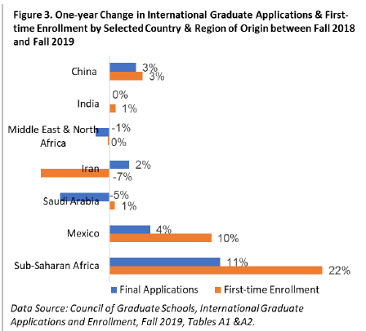

Slide 27
Will Coronavirus Crisis Trigger an Enrollment Crisis?
InsideHigherEd.com/News
“Just how severe the impact will be will depend on many unknown variables, among them: how long the outbreak will last, whether or to what degree it can be relatively contained, when local and international travel restrictions may be lifted, whether Chinese colleges and schools reopen in time to finish their terms more or less on schedule, and how damaging the virus ultimately ends up being to the Chinese -- and indeed the global -- economy.” - Elizabeth Redden
https://www.insidehighered.com/news/2020/02/13/longer-coronavirus-crisis-persists-bigger-likely-impact-chinese-student-enrollments#.XkxxJIy5hqg.email

Slide 28
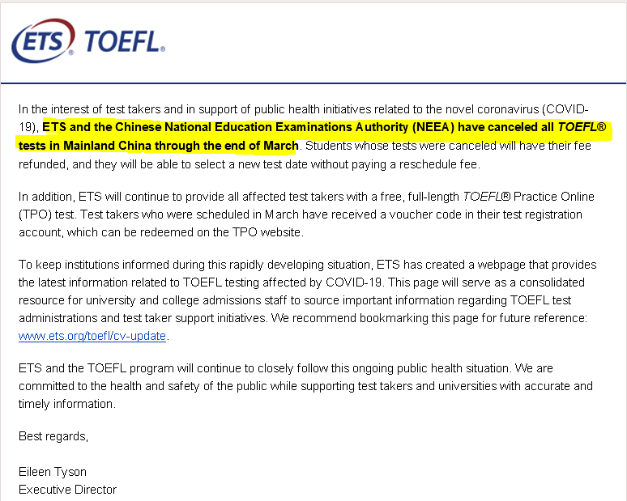
Notes:
Below a screenshot of the application deadline change form that is located as a category in helpdesk request submission page here http://www.uh.edu/graduate-school/contact-us/ .
The category is located at the very bottom of the drop down menu under ‘UH Faculty and Staff Requests’.
The form ask for Program/Plan code, Application Type (Dom, Intl or Both) and whether they want to have the deadlines published on the UHGS website.

Slide 29
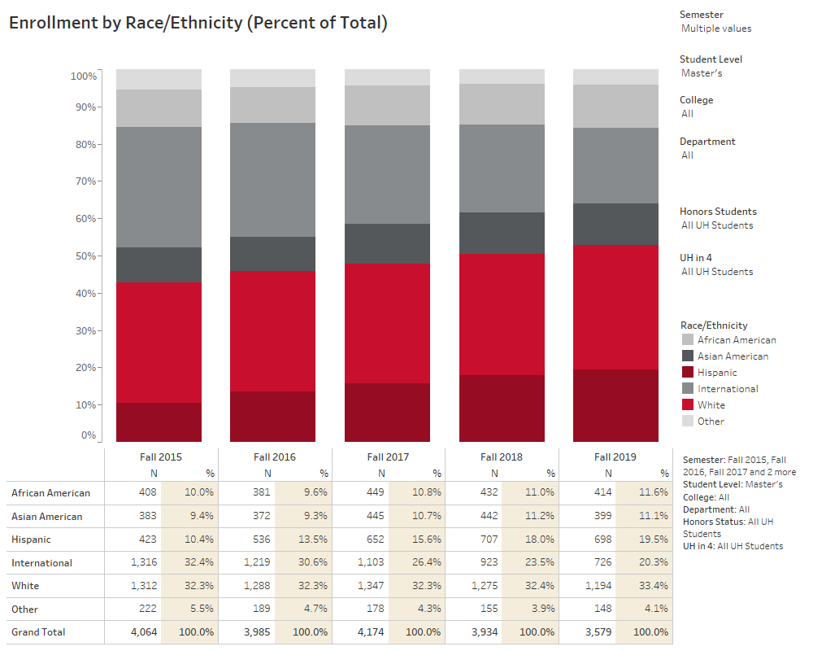
http://www.uh.edu/ir/.
Notes:
New Staff/Transitional

Slide 30
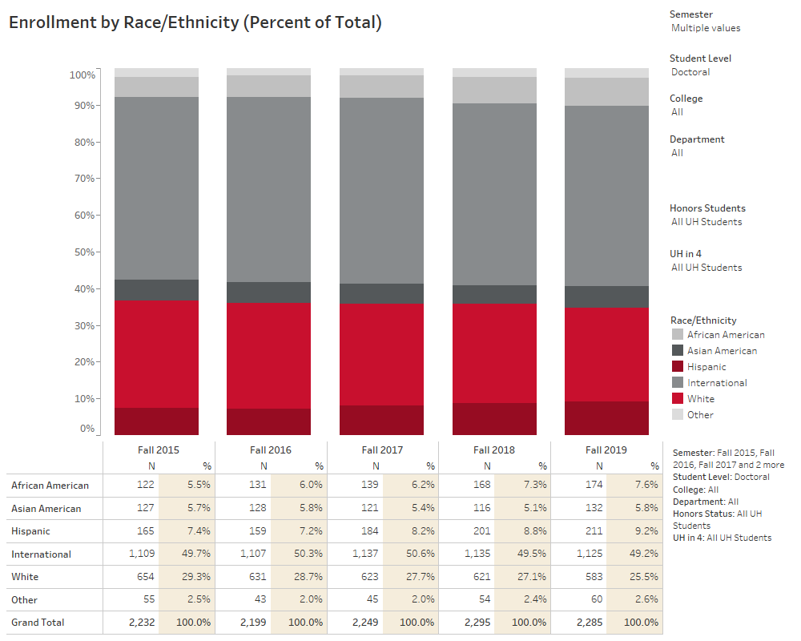
http://www.uh.edu/ir/

Slide 31
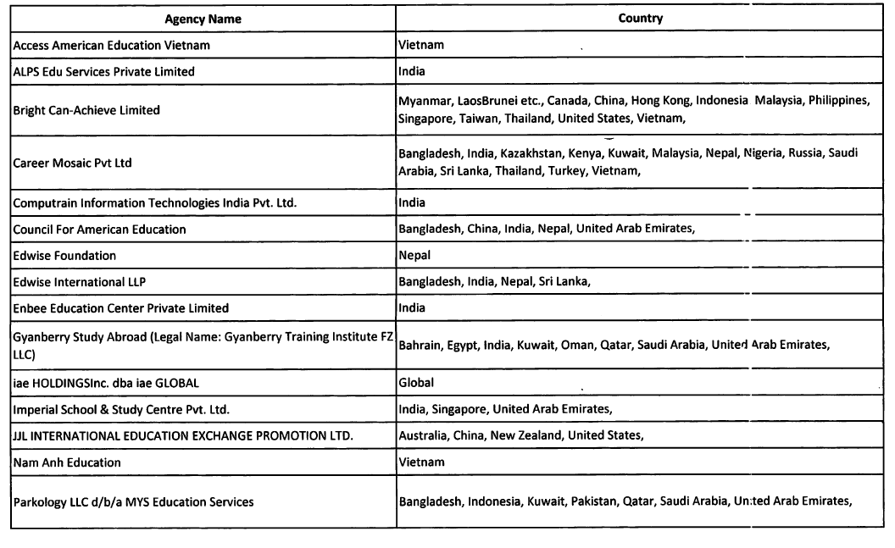
International Recruitment

Slide 32
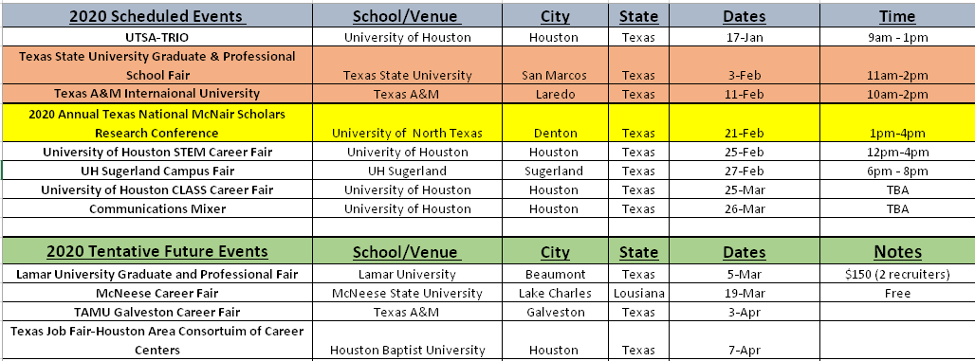
GS Recruitment Calendar

Slide 33
Reminders
Feb 28th (Archiving Spring 2020)
Applications
Fa2020 Grad Fair Event – October 1st
Extending of Application Deadlines for FA2020
90 app’s currently pending a decision
No decision – Applications will be changed automatically to ”Withdrawal Status” in CN and withdrawal letters released.
Remove Decision Response in CN

Slide 34

Decision Response
Notes:
New Staff/Transitional

Slide 35


Slide 36
I-20 processing
Christen Powers
SEVIS Compliance Coordinator

Slide 37
I-20 Changes
Students must coordinate shipping of their document through issuing DSO.
  For new Graduate Admits, that is Christen Powers
  Document Shipping Options
    Courier Service (at the expense of the student)
    US Airmail
      Not trackable, and can take several weeks to deliver.
Notes:
New Staff/Transitional

Slide 38
I-20 Changes
SEVP restrictions on third party shipping
  Policy Details
    https://studyinthestates.dhs.gov/2019/06/sevp-publishes-guidance-on-recruiters-and-the-form-i-20
  Appeal Process
    There is a limited appeal process for those who live in countries that do not have access to courier service.
      The student must request an appeal to the above policy and provide documentation of the inability to receive the I-20 visa courier

Slide 39
I-20 Changes
Appeal Process
  If the applicant wants to ship the document to a third party.
    The applicant must fill out a new form, which will be available from me
    The applicant must provide the name , relationship, and location of their designee
      This address must still be overseas, as new initial documents must be shipped overseas.

Slide 40
I-20 reminders
Fill out the I-20 request completely
  There are a few changes to the I-20 request
    The option to select delivery to academic department has been removed.
    This option has been replaced with an acknowledgement of submission.
  The request must be fully completed in order to submit the request.

Slide 41
I-20 reminders
New requests will be evaluated within 1-2 business days of reciept.
  This does not mean from the moment you submit it
    The student must have accepted their admission in order for me to see the request
Notes:
New Staff/Transitional

Slide 42
I-20 reminders
New requests will be evaluated within 1-2 business days of reciept.
  This does not mean from the moment you submit it
    The student must have accepted their admission in order for me to see the request
Processing can take 5-7 business days before it is ready to review
Notes:
New Staff/Transitional

Slide 43
Chastyne Blacklock
Executive Assistant to Dean Larsen & Events Coordinator

Slide 44
Below are our upcoming events:
Graduate Appreciation Week (4/8 Ice Cream Social in Grad office)
April 6 – April 9
Dissertation Boot camp – Writing Center
May 11 – May 14
Graduate Orientation – Student Center
August 18th
Graduate Fair – Lynn Eusan Park
October 1st
Graduate Research Showcase
TBD
Notes:
New Staff/Transitional

Slide 45
QUESTIONS???
Thank you for attending and thank you for all that you do to assist the Graduate School and our students!
Notes:
New Staff/Transitional

