Slide 1

GRADUATE SCHOOL UPDATES & REMINDERS
GRAD ADVISOR ZOOM MEETING
4/28/2020
10:00 – 11:00 am
Meeting will start shortly. Please mute your mics and turn off your video.

Slide 2
Sarah Larsen
Vice Provost & Dean, Graduate School

Slide 3
Professional Development
Dissertation Accelerator- registration open- online May 11-14
https://uh.edu/graduate-school/academics/thesis/dissertation_accelerator/
Online professional development via DoctoralMastersNet
Student to Student: How to keep your grad work consistent through a busy life?
Friday, April 10, 2020 · 03:30:00 PM
UH student requesting link to webinar:
“I am from University of Houston. Your webinar really helps.”
Grant-writing/Fellowship workshop- virtual, early June- capacity of ~50 students

Slide 4
COVID-19 issues
Updates:
Admitted students: https://uh.edu/graduate-school/covid19-updates/prospective-admitted-students.php
Current students:
https://uh.edu/graduate-school/covid19-updates/current-students.php

Slide 5
GPSC approvals at April meeting
Approved use of Duolingo scores for English Language proficiency on a permanent basis
Approved the GRE/GMAT waiver program for UH undergraduates applying to UH master’s programs (has been on a temporary basis since 2017- now permanent)
Approved a process by which programs may request temporary suspension of GRE/GMAT requirements for Fall 20/Spring 21 (several requests subsequently approved)

Slide 6
Process to request GRE/GMAT waiver
Memo with the following information sent to me from Associate Dean:
1) Program name and College
2) Specific request (waive the test scores for all applicants or for applicants with particular qualifications) and proposed length (Fall 2020, Spring 2021)
3) Short description of how applications will be evaluated in the absence of standardized test scores
We will then remove the test score question from the application.
Scores will still be loaded into the system if students send them via ETS reporting.

Slide 7
Shawn Washington
Associate Director of Grad/Int’l Admissions.

Slide 8
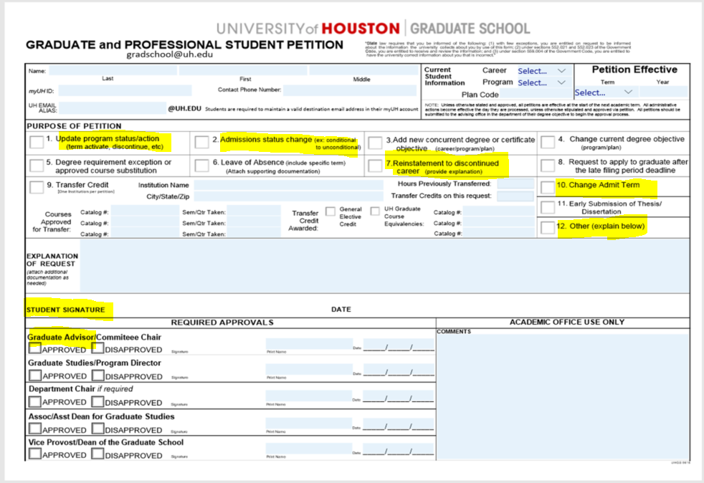
http://www.uh.edu/ir/

Slide 9
Special Admit Petition Reminders:
GRE/GMAT Test Scores:
https://uh.edu/graduate-school/admissions/gre-gmat-waiver/
Unofficial “self-reported” Documents (Transcripts)
- Special Admit Petition
- Petition to remove Prior Degree Verification Hold
Remember to include needed signatures and any supporting documents.
Notes:
New Staff/Transitional

Slide 10
Extending Application Deadlines
Submit program name and code?
International or Domestic?
How long to keep application open?
Notes:
New Staff/Transitional

Slide 11
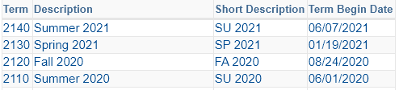

Deferral Requests
Graduate and Professional Student Petition is needed for all new students “matriculated” for FA2020.
No deferments processed after ORD (Census).
Graduate School Policy – New students can defer their admission up to two future terms.
Currently, no deferments can be processed for FA2021 until PS is updated:

Slide 12
Application Deadlines
In an effort to help streamline the processing of each program’s application deadlines for the coming SP2021, SU2021, and FA2021 recruiting cycles or terms; we rolled over and entered last years’ deadlines into the ApplyWEB (CollegeNET) application system. We also; for some programs, changed the application deadlines that were originally scheduled during the winter-break period from January 1st to January 15th to give applicants the opportunity to seek any real-time customer service needed. However, we can revert the new updated January 15th application deadline back to January 1st; if requested to do so.
Notes:
Below a screenshot of the application deadline change form that is located as a category in helpdesk request submission page here http://www.uh.edu/graduate-school/contact-us/ .
The category is located at the very bottom of the drop down menu under ‘UH Faculty and Staff Requests’.
The form ask for Program/Plan code, Application Type (Dom, Intl or Both) and whether they want to have the deadlines published on the UHGS website.

Slide 13
Hard-Copy mail
https://uh.edu/af-university-services/copy-print-and-delivery-services/index.php
Domestic applicants should request a electronic copy of their transcripts.
Forward questions about delivered mail to gradschool@uh.edu.
Notes:
New Staff/Transitional

Slide 14


Slide 15
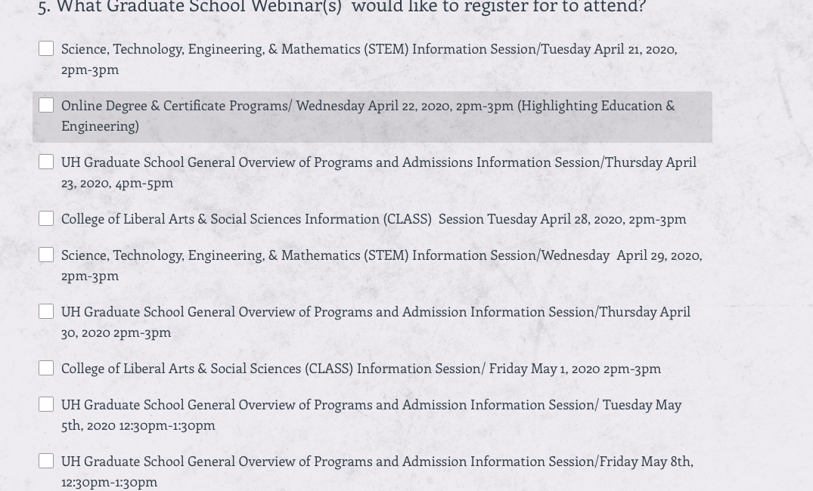
Virtual Information Sessions- Registration page

Slide 16
Tashemia Jones
Assistant Director, Academic Affairs Graduate School

Slide 17
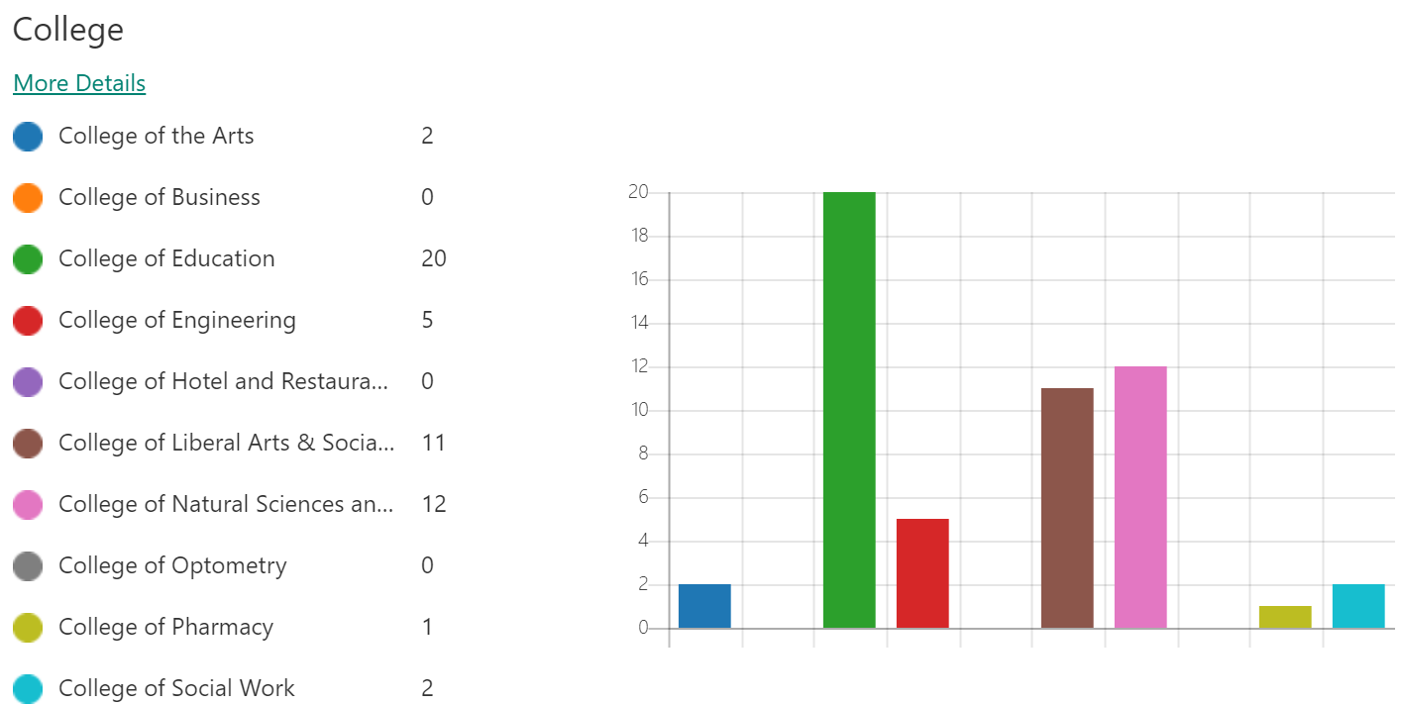
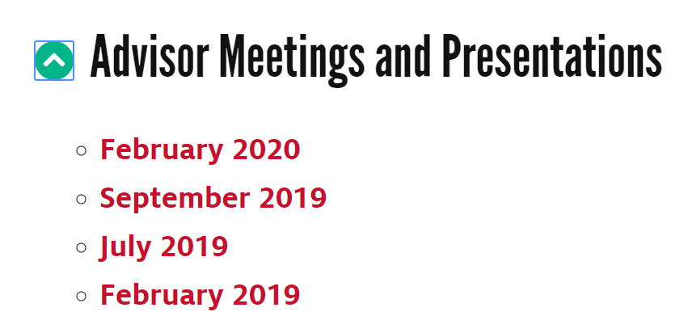
ACADEMIC AFFAIRS
Dissertation Accelerator Online
May 11-14th
Notes:
New Staff/Transitional

Slide 18
Rachel Honora
Associate Registrar
Office of the University Registrar

Slide 19
Interim Grading policy
Applies to Graduate and Optometry Students
Enrolled in Spring 2020 (Sessions 1, 4, 5,6) and Summer 2020
Updated Grading Schemes
  Grades of A – B- will not be converted
  Grades of C+ to C- will automatically convert to S
  Grades of Unsatisfactory (U) and Failing (F) will automatically convert to No Credit Reported COVID19 (NCR).
  Satisfactory (S) and No Credit Reported COVID-19 (NCR) grades are not factored into term or cumulative GPA.
Incomplete grades: The deadline for completing course requirements associated with Incomplete grades due in spring 2020 is extended to August 10, 2020. Students should contact their instructors to discuss plans for completing course requirements by that date. The incomplete deadline extension will be reviewed for continuation through future terms if necessary.
Links to policy and FAQ’s:
  https://uh.edu/provost/policies-resources/student/interim-graduate-grade-policy/index
  https://uh.edu/graduate-school/covid19-updates/faq.php
Notes:
New Staff/Transitional

Slide 20
Graduate grading scheme
Roster Grade | Grade
A | A
A- | A-
B+ | B+
B | B
B- | B-
C+ | S
C | S
C- | S
D+ | NCR
D | NCR
D- | NCR
F | NCR
I | I
NR | NR
S | S
U | NCR
W | W
Notes:
New Staff/Transitional

Slide 21
The process
Students will see two grades in myUH
  Roster Grade and Grade
  Roster Grade is assigned by instructor
  Grade will appear on the academic transcript
Checklist – GCOVID
  Go to the “Student Center” in your myUH account
  Click on your To-Do List
  Click on “Details and Upload Documentation”
  Click on “GRAD Interim Grade Policy Req”
  Click on “Graduate Interim Grading Form” https://uh.edu/academics/forms/interimgradingform-grad.pdf
  Fill out the form and save it
  Upload the completed form
The deadline to submit forms is May 18 at 5pm
Notes:
New Staff/Transitional

Slide 22
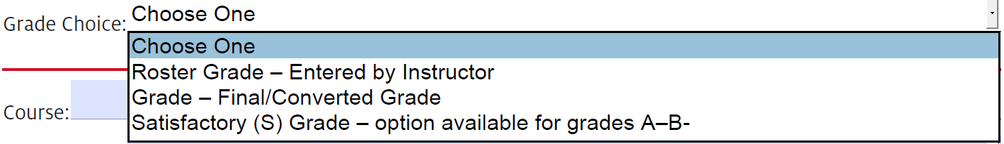
Graduate interim grading form
Students may add up to 5 courses
Grade Choices
  Roster Grade
  Grade – Final/Converted Grade
  Satisfactory (S) Grade – option available for grades A – B-
Notes:
New Staff/Transitional

Slide 23
Stefan Johnsson
SEVIS Compliance Sr. Coord.
International Student and Scholar Services Office

Slide 24
Program Ending Date
F-1 Students cannot extend their program if they have met all degree requirements
Notes:
New Staff/Transitional

Slide 25
I-20 Program Extension
Form is here: https://uh.edu/oisss/students/f-1-f-2-visa/f-1/i20-program-extension/
I-20 Extensions require a valid reason to extend a student’s program dates.
Failure to apply for graduation is not a valid reason. If a student has met all degree requirements, but failed to apply for graduation, please let me know. They are required to either apply for OPT, go home, change their status, or start a new degree program for fall 2020 within 60 days following the end of the semester.
  Long term consequences for purposely delaying graduation is that a student will be unable to apply for OPT and have lost their status.
Notes:
New Staff/Transitional

Slide 26
I-20 Program Extension
I-20 program extensions cannot be done after a student’s I-20 program end date has past(expired).
Summer semester is online only. This means that F-1 students can take only online courses for summer to graduate due to COVID-19.
  This is an exception to the rule.
Notes:
New Staff/Transitional

Slide 27
OPT related
Students cannot apply for OPT while in their home country. They have to be here(in the U.S.) to apply.
  Cannot come back in their grace period to apply (after end of semester)
If a student has applied for OPT and cannot complete their thesis/dissertation, they can enroll for the next semester and still maintain status as long as it’s thesis/dissertation hours ONLY.
Students having to enroll in additional courses(not thesis/dissertation related) have to extend I-20 prior to the program end date or will be out of status. (May 6th is official semester closing date)
Further scenarios or questions on this, please follow up with our office, do not attempt to advise F-1 students on their status. This is for your informational use only.
Notes:
New Staff/Transitional

Slide 28
Questions
Thank you for all that you do!
This presentation will be uploaded to the Grad Advisor Resource page and emailed out to everyone following the meeting.
Notes:
New Staff/Transitional

